Slide 1
LaunchPad GymMix Lesson Planner Manual for Users
June 2017

Slide 2
Contents
About the GymMix Lesson Planner
Who can access the GymMix Lesson Planner?
How can I access the GymMix Lesson Planner?
GymMix Lesson Planner Help
How to Create a Lesson Plan
How to View a Lesson Plan
How to Update a Lesson Plan
How to Clone a Lesson Plan
How to Delete a Lesson Plan
Support

Slide 3
About GymMix Lesson Planner
The Launchpad GymMix Lesson Planner is a resource developed by Gymnastics Australia.
The aim of this resource is to assist club coaches and teachers to deliver quality recreational gymnastics programs that will provide participants with the skills to enjoy gymnastics in both clubs and schools.
The GymMix Lesson Planner website is:
An innovative Lesson Plan builder that progressively builds safe and challenging gymnastics lessons which:
Draws from over 1000 pre-selected games, activities and skills
Offers the ability to print, clone and save your lesson plans for record keeping and future use.
Provides A4 activity cards that can be printed for future use.

Slide 4
Who can access GymMix Lesson Planner?
To access the GymMix Lesson Planner, users need to be set up in Gymnastic Australia’s database as one of the following users:
Option | User | Member Type (iMIS) | Category | Associated with Sporting School | Completed Ignite Course | Subscription Duration | Subscription Fee
1 | Tech Member | Tech Member | Any |  |  | No anniversary | Free ongoing
2 | Teacher (non-member) | Other | Teacher |  | ü | 12 months | Free for first 12 months $77 on renewal
3 | Sporting School Contact (non-member) | Other | None | ü |  | 12 months | Free for first 12 months $77 on renewal unless school re-signs Sporting school contract
4 | Staff (GA and State) | Staff | N/A |  |  | No anniversary | Free ongoing

Slide 5
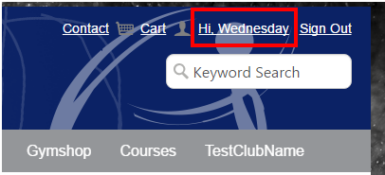
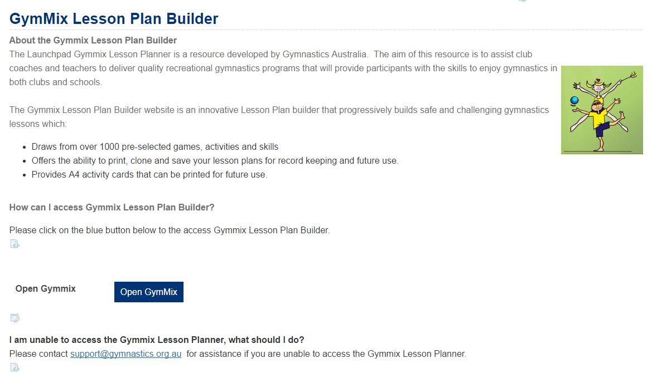
How can I access the GymMix Lesson Planner?
Log into Gymnastics Online
Go to website http://gymnastics.org.au/
Click on Sign In link located in the top right hand corner of the screen.
A log in page will appear.
Please use the user name and password provided in a separate email.
Select the OK button.
Select the link in the top right hand corner Hi, <Your Name>.
The My Account Page appears.
Click on the GymMix link located on the blue ribbon on the My Account Page
This link will display if you are a current GymMix subscriber as per slide 4.
Log into GymMix Lesson Planner from Gymnastics Online
Please click on the Button to Open GymMix
The GymMix Lesson Planner website will open in a new tab in the user’s internet browser.

Slide 6
Help Section
The Help section of the GymMix Lesson Planner provides a wealth of in-depth information on the best practice to build lesson plans.
We recommend referring to this Help section as well as this PowerPoint presentation to learn how to effectively use the GymMix Lesson Planner.

Slide 7
How to Create a Lesson Plan: Step 1: Go to Lesson Plans section
Click on Lesson Plans in the top ribbon

Slide 8
How to Create a Lesson Plan: Step 2: Create New Plan
Click on the Create New Plan button

Slide 9
How to Create a Lesson Plan: Step 3: Complete Lesson Plan Details
Please complete the following fields as they are mandatory:
Field | Notes
Lesson Title | Enter the name of the lesson
Select DMPs | You need to select at least 2 dominant movement pattern categories which will influence the activities displayed in the lesson planner.
Linked with Unit Plan | The Unit Plan is a summary of each Lesson Plan’s activities.
Coach/Teacher Name | Enter the name of the coach or teacher
Responsibility | Please check the box if you responsible for running a lesson.
Term and Lesson No. | Please use one of these fields to record the date of the lesson in your preferred format.
Today’s Date
Aim of the Lesson | Enter the aim(s) of the lesson.
Equipment Required | Enter the equipment required for the lesson.
Names of Assisting Coaches | Enter the name(s) of any assisting coaches.
Please select the Continue button to proceed to the next page.

Slide 10
How to Create a Lesson Plan: Step 4: Plan Warm Up Activities
Use the filters to find appropriate activities for your participants
Drag and drop activities from the Skills Library to the Selected Skills area.
Drag and drop activities in the Selected Skills area to change their order.
Use the page numbers to view more warm up activities.
Enter notes about warm up activities in the Notes field
Please select the Continue button to proceed to the next page.

Slide 11
How to Create a Lesson Plan: Step 5: How to delete selected activities
To delete activities from the selected skills area, just hover your mouse over the activity to view a Trash Can icon.
Then click on the Trash Can icon to remove the activity.
Alternatively you can drag and drop the activity back to the Skill Library explorer.

Slide 12
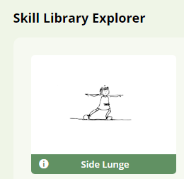
How to Create a Lesson Plan: Step 6: View & Print Activity Cards
Click on the information icon on an activity in the Skills Explorer to view an Activity Card.
To print an Activity card, please select the Print button.

Slide 13
How to Create a Lesson Plan: Step 7: Use Skill Library Explorer Filters
There are 3 types of Skill Library Explorer filters to use to find activities that are appropriate for your lesson’s participants:
Activity Type filter
Level of Challenge Filter
Reference Search
To execute the search, ensure that you click on the Search button.

Slide 14
How to Create a Lesson Plan: Step 8: Plan Skills Activities
Use the filters to find appropriate activities for your participants
Drag and drop activities from the Skills Library to the Selected Skills area.
Drag and drop activities in the Selected Skills area to change their order.
Use the page numbers to view more skills activities.
Enter notes about skills activities in the Notes field
Please select the Continue button to proceed to the next page.

Slide 15
How to Create a Lesson Plan: Step 9: Plan Circuit Activities
Use the filters to find appropriate activities for your participants
Drag and drop activities from the Skills Library to the Selected Skills area.
Drag and drop activities in the Selected Skills area to change their order.
Use the page numbers to view more circuit activities.
Enter notes about circuit activities in the Notes field
Please select the Continue button to proceed to the next page.

Slide 16
How to Create a Lesson Plan: Step 10: Plan Cool Down Activities
Use the filters to find appropriate activities for your participants
Drag and drop activities from the Skills Library to the Selected Skills area.
Drag and drop activities in the Selected Skills area to change their order.
Use the page numbers to view more cool down activities.
Enter notes about cool down activities in the Notes field
Please select the Continue button to proceed to the next page.

Slide 17
How to Create a Lesson Plan: Step 11: Review Lesson Plan
Review lesson plan selections.
Click on the Continue button to proceed to the next page.
Selecting the Continue button on this page will save your lesson plan.

Slide 18
How to Create a Lesson Plan: Step 12: Download Lesson Plan
To download your lesson plan in PDF format, please select the Download button.
The PDF will download to the folder location where your browser is set to downloads files to.
Please select the Return Home button to return to the Lesson Plan page.

Slide 19
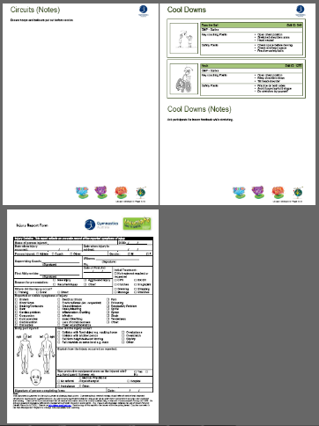
How to Create a Lesson Plan: Step 13: Review downloaded PDF Lesson Plan

Slide 20
How to View a Lesson Plan
To view an existing lesson plan, ensure that you have selected the Lesson Plan link on the Top Menu.
Once on the Lesson Plan page, please select the Eye Icon to view an existing lesson.

Slide 21
How to Update a Lesson Plan Step 1
To updated an existing lesson plan, ensure that you have selected the Lesson Plan link on the Top Menu.
Once on the Lesson Plan page, please select the Eye Icon to view an existing lesson.

Slide 22
How to Update a Lesson Plan: Step 2
Select the Previous button to return to section(s) which you wish to update.
Once this has been completed, select the Continue buttons on each page until you return to the download lesson plan page.

Slide 23
How to Clone a Lesson Plan: Step 1
To clone an existing lesson plan, ensure that you have selected the Lesson Plan link on the Top Menu.
Once on the Lesson Plan page, please select the Arrow Icon to clone an existing lesson.

Slide 24
How to Clone a Lesson Plan: Step 2
A pop-up message will appear.
Select the OK button to proceed with cloning the lesson plan.

Slide 25
How to Clone a Lesson Plan: Step 3
A Lesson Plan details page will appear.
Please update all fields.
You will need to enter a new date or Term and Lesson Number for this lesson before cloning.
To proceed with the clone, please click on the Clone button.

Slide 26
How to Delete a Lesson Plan Step 1
To delete an existing lesson plan, ensure that you have selected the Lesson Plan link on the Top Menu.
Once on the Lesson Plan page, please select the Trash Bin Icon to clone an existing lesson.

Slide 27
How to Delete a Lesson Plan Step 2
A pop-up message will appear.
Select the OK button to proceed with deleting the lesson plan.

Slide 28
Support
As a first step, please visit the Help Section on the GymMix Lesson Planner for in-depth information on how to use this new resource.
For support with GymMix, please log a support ticket either via:
http://support.gymnastics.org.au
support@gymnastics.org.au
Please email all screen shots as attachments if you choose the email method to raise a support ticket.

