Slide 1
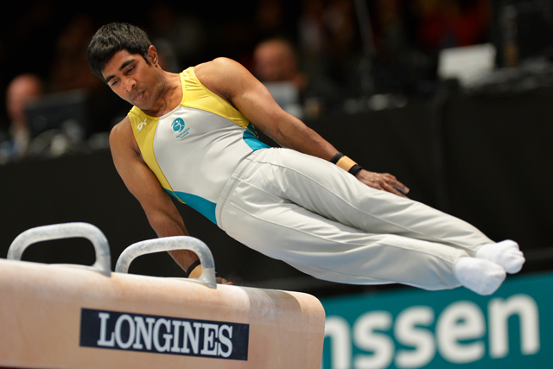
New Club Importer Upload Process
January 2019 Version 1.0

Slide 2
Contents
About the New Club Importer
How to access the Club Importer
Fields required for the new Club Importer
Export Existing Records in correct Club Importer format
How to access the Club Importer & Validation Template
How to Import a CSV file into the Club Importer
What if I need an athlete registered urgently?
Troubleshooting Error Messages & Failed Imports
Need Help?

Slide 3
About the New Club Importer

Slide 4
About the New Club Importer
Gymnastics in Australia have implemented a new Club Importer tool so that all clubs around Australia regardless of the software they use (or not) to manage their class bookings have an improved experience of importing their current athletes and their athlete codes in bulk into the National Gymnastics Database.
Features of the new Club Importer tool:
Ability to import a large number of athletes at one time without having to batch imports.
Club Administrators are able to review, know records which will not be imported, correct issues and update athlete details prior to an import being written to the database.
No longer have to wait for an onscreen upload – imports are queued to improve CRM performance.
Club Administrators are notified of a Club Import’s progress via email notifications and a Club Import dashboard.
The import can be worked on by any club administrator in a Club and doesn’t require to be completed in one session.
There is a log of records available via new reports in Club Admin Home> Reports which show what has been successfully uploaded and what has not been which can be worked through at any time.
New report which can be used to export your Club’s athletes from the Club Admin Portal with the correct club import format (Club Admin Portal> Reports> R. Club Importer Export).

Slide 5
What has changed?
Updated club import headers and requirements – more information can be found here.
New validation template – more information can be found here.
CSV file required to import (previously excel)
NO COMMAs – if you have a comma in any fields these must be removed as we have moved to CSV (Comma delimited files). Commas are used to separate fields and will result in any records not importing correctly and requiring to be fixed. More information on how you can do this in bulk in excel.
No need to batch imports – put all your athletes in one file.
All Athletes now require at least 1 Athlete Code every import.
Athletes can have up to 3 different Athlete Codes per import.
Incorrect and incomplete Athlete Codes will not be imported into the system and will be required to be fixed before data is written into the database.
All phone number fields require 10 digits only (the system will remove special characters and spaces) eg. Landline 0386989718 or Mobile 0411222333
No need to trim leading/trailing spaces in fields as this is automatically done by the system
The following fields are no longer required:
State Association (this gets automatically updated as per the Club’s state association)
Fax
Address3
Date Achieved (this field will be phased out as we assume every time a new athlete code is registered is when it was achieved)
Paid Thru (automatically updated to the year the file was updated in)

Slide 6
How to access the Club Importer

Slide 7
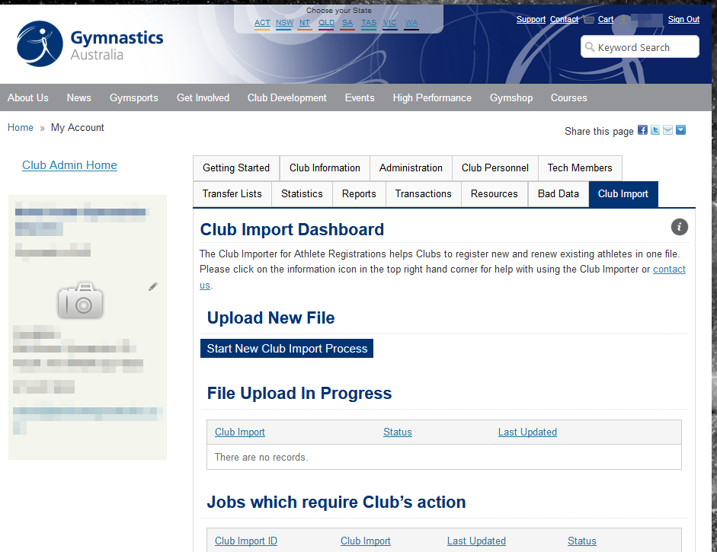
How to access the Club Importer
To access the Club Importer, please go to the Club Admin Portal and then click on the Club Importer tab.
To access further information about using the Club Importer, please click on the information icon.

Slide 8
Fields required for the new Club Importer

Slide 9
Where can I find report requirements?
https://support.gymnastics.org.au/article/177-new-club-importer-report-requirements

Slide 10
Fields required for the new Club Importer Part 1
Mandatory fields are highlighted in yellow = must have required information to import
Column Number | Column Header | Is this field mandatory for Gymnastics Australia club importer to work? | Recommended column format in Excel | Notes
1 | LastName | Yes | Text | These must be separate fields Character limits: First Name: 20 characters Middle name: 20 characters Last Name: 30 characters Leading spaces in name must be removed – otherwise this creates a new record. No commas
2 | FirstName | Yes | Text
3 | MiddleName | No | Text
4 | Email | Yes | Text | Must be a valid email address eg. Needs to have a @ No commas
5 | Birthdate | Yes | Date | Must be formatted DD/MM/YYYY Cannot be a date in the future (exceeds today) or too far in the past (over 90 years ago) Athletes over 90 yrs should use the bulk renew or individual athlete registration form.
6 | Gender | Yes | Text | Must be either F (for female) or M (for male) We are currently working on a non-binary option but this is not available until future system upgrade. Workaround TBC
7 | WorkPhone | No | Text | Can be a mobile phone eg. 04112223333 Needs to only be numbers (spaces and special characters are dropped the by system) Must be 10 digits eg 0386989718 Must include area code if landline eg. 0386989718 Must be exported as text column so 0 does not get dropped by excel.

Slide 11
Fields required for the new Club Importer Part 2
Mandatory fields are highlighted in yellow = must have required information to import
Column Number | Column Header | Is this field mandatory for Gymnastics Australia club importer to work? | Recommended column format in Excel | Notes
7 | WorkPhone | No | Text | Can be a mobile phone eg. 04112223333 Needs to only be numbers (spaces and special characters are dropped the by system) Must be 10 digits eg 0386989718 Must include area code if landline eg. 0386989718 Must be exported as text column so 0 does not get dropped by excel.
8 | HomePhone | Yes | Text | Can be a mobile phone eg. 04112223333 Needs to only be numbers (spaces and special characters are dropped the by system) Must be 10 digits eg 0386989718 Must include area code if landline eg. 0386989718 Must be exported as text column so 0 does not get dropped by excel. Recommend copying mobile phone into this field if empty
9 | Mobile | No | Text | Needs to only be numbers Must be 10 digits eg. 0411222333 Must be exported as text column so 0 does not get dropped by excel.
10 | Address1 | Yes | Text | Character limit: 40 characters No commas
11 | Address2 | No | Text | Character limit: 40 characters No commas

Slide 12
Fields required for the new Club Importer Part 3
Mandatory fields are highlighted in yellow = must have required information to import
Column Number | Column Header | Is this field mandatory for Gymnastics Australia club importer to work? | Recommended column format in Excel | Notes
12 | City | Yes | Text | Please enter suburb in this field. No commas
13 | State | Yes | Text | States must be in the format eg. ACT, NT, NSW, QLD, VIC, TAS, WA
14 | PostalCode | Yes | Text | Must be 4 numbers eg. 2611 Must be exported as text column so 0 does not get dropped in NT postcodes
15 | EmergencyContact | No | Text | Character limit: 30 characters No commas
16 | EmergencyNumber | No | Text | Can be a mobile phone eg. 04112223333 Needs to only be numbers (spaces and special characters are dropped the by system) Must be 10 digits eg 0386989718 Must include area code if landline eg. 0386989718 Must be exported as text column so 0 does not get dropped by excel.
17 | GuardianAddress | No | Text | Character limit: 40 characters No commas

Slide 13
Fields required for the new Club Importer Part 4
Mandatory fields are highlighted in yellow = must have required information to import
Column Number | Column Header | Is this field mandatory for Gymnastics Australia club importer to work? | Recommended column format in Excel | Notes
18 | Gymsport1 | Yes | Text | This corresponds to the Athlete Coding Guide which is released in December annually by Gymnastics Australia. All athletes need to have 1 gymsport and level (athlete code) defined in order to be imported. Codes which are either not in the current Athlete Coding Guide or incomplete will be registered as undefined and in the bad data reports tab. Athletes can now have up to 4 different Athlete Codes (Gymsport and Level) defined on the same line. If your system does not record Athlete Codes, we recommend you have only the header and the Club will need to complete this information before importing. Must be exported as text column so 0 does not get dropped by excel in some levels.
19 | Level 1 | Yes | Text
20 | Gymsport2 | No | Text
21 | Level2 | No | Text
22 | Gymsport3 | No | Text
23 | Level3 | No | Text

Slide 14
Export Existing Records in correct Club Importer format

Slide 15
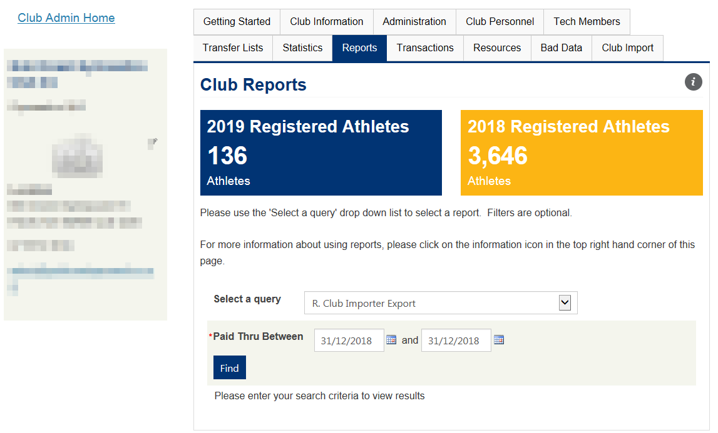
How to export Existing Records in correct Club Importer format – Part 1
Go to the Club Admin Portal> Reports tab> R. Club Importer Export
Select the Paid Thru dates you wish to display athletes and then click on the Find button to run the report.

Slide 16
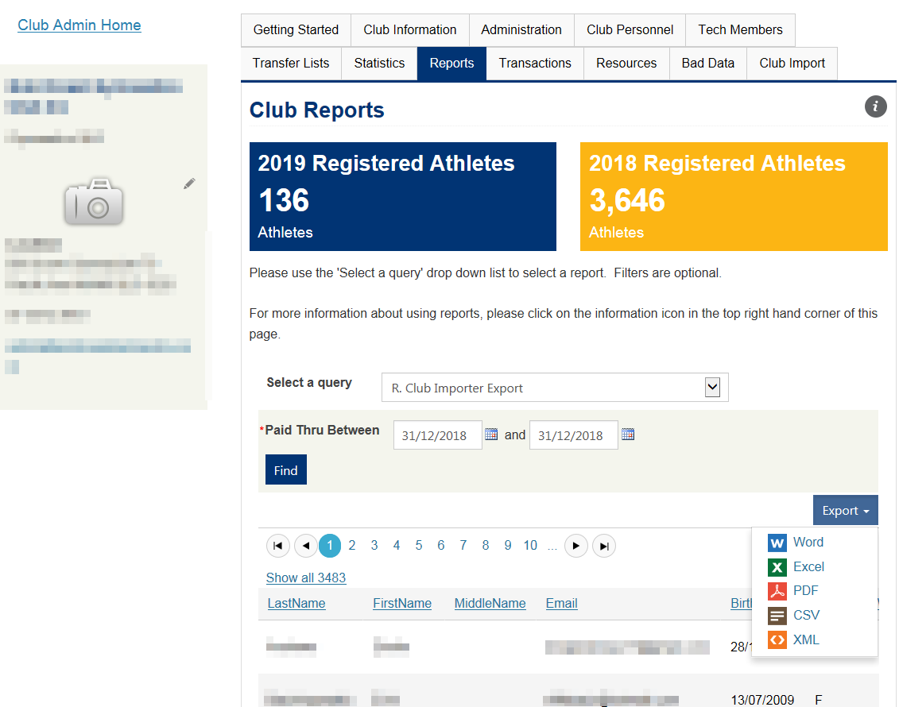
How to export Existing Records in correct Club Importer format – Part 2
Please click on the Export button and then select Excel.
Important: Please do not select CSV as it drops the zeros in the phone numbers and saves in the wrong CSV format.

Slide 17
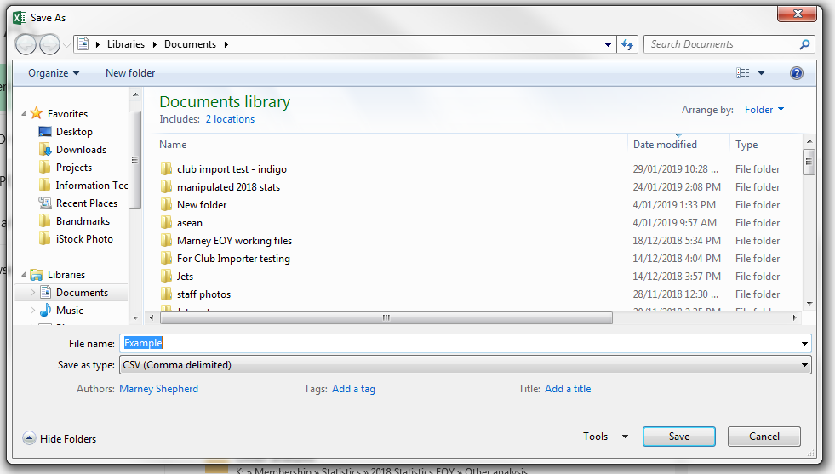
How to export Existing Records in correct Club Importer format – Part 3
Open the excel file you have just created.
Enable editing if you have a protected view.
Select Save As option in your excel
Ensure you save as a CSV (Comma delimited).
Important: Please do not save as any other CSV file types as the club importer will not work.

Slide 18
How to export Existing Records in correct Club Importer format – Part 4
Please note that the file has all the fields with the correct headers for the club importer.
We recommend using the Club Importer Validation template to help identify any incomplete and invalid data, ensure you are using the latest Athlete Codes and to automatically copy mobile phone numbers into the home phone field.
Important: Due to an issue around date formatting, we have suspended CSV imports into the Validation Template. Excel files can still be imported into the Validation Template and the file for importing into the Club Importer wizard is still CSV.

Slide 19
How to access the Club Importer & Validation Template

Slide 20
How to access the Club Importer
To access the Club Importer, please go to the Club Admin Portal and then click on the Club Importer tab.
To access further information about using the Club Importer, please click on the information icon.
Please click on this button to access the latest Validation template.

Slide 21
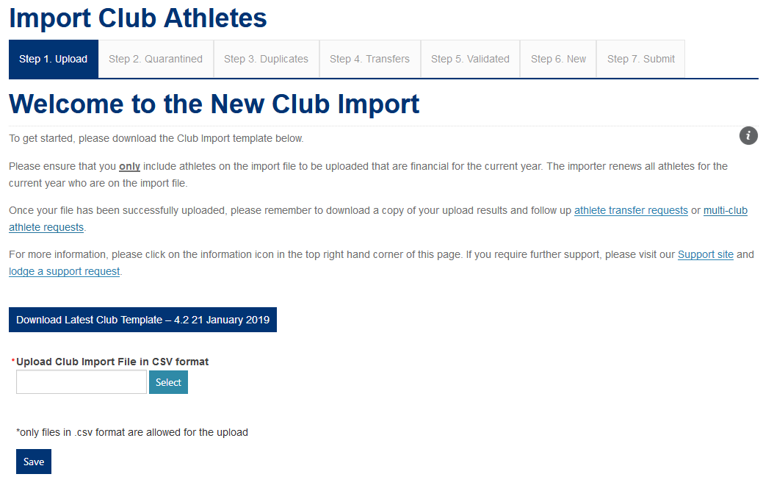
How to download latest Validation Template
This is always the latest template.

Slide 22
How to Import a CSV file into the Club Importer

Slide 23
Overview of Club Importer Process
1. Ensure your information is using the report headers and requirements as per this page
2. Import the data into the Validation template to pick up and correct data errors early.
1. Ensure your information is using the report headers and requirements as per this page
3. Create a Club Import CSV file (IMPORTANT do not open file as you will lose zeros at start of phone numbers)
4. Open Club Admin Portal and go to Club Importer tab
5. Start new Club Import process and import CSV file as a new job
6. Review validated CSV file job, follow up any actions and then submit file for processing
7. File gets put into a queue with other imports to have records updated/created
8. Receive Club Import job has completed. This can be confirmed via Club Admin Home> Reports> Current Year Athlete Reports

Slide 24
Overview of Club Importer System Workflow (if not failed or cancelled)
Import new file
File Upload in Progress
Status: Upload in Progress
Pending & Completed Jobs
Status: Review
Jobs which require Club’s action
Status: Validated
Please ensure your Club uses a file which meets NEW requirements
The file upload is queued. The records will not be written to the database at this stage.
Your file upload is in progressThe records will not be written to the database at this stage.
Your file upload is now ready to be actioned by your Club via Validated button. The records will not be written to the database at this stage.
Press submit button after review of validated
Pending & Completed Jobs
Status: Pending
Pending & Completed Jobs
Status: Processing
Pending & Completed Jobs
Status: Completed
To iniate the validated records being written to the database, please ensure you have click on the submit button in Step 7 .
Your job’s validated records have been queued to be written to the database.
Your job’s validated records are currently being written to the database.
Your club’s validated records have been written to the database and you can check these records via Reports> Current Year Athletes

Slide 25
What does the import wizard use to flag entries in each step?
The import wizard uses the following matrix as a guide to flag entries during each stage of the process. For example, an account that requires a transfer is flagged because the importer has matched a line on the import file with an existing account that has the same First Name, Last Name, Date of Birth and additionally exists already in another club.

Slide 26
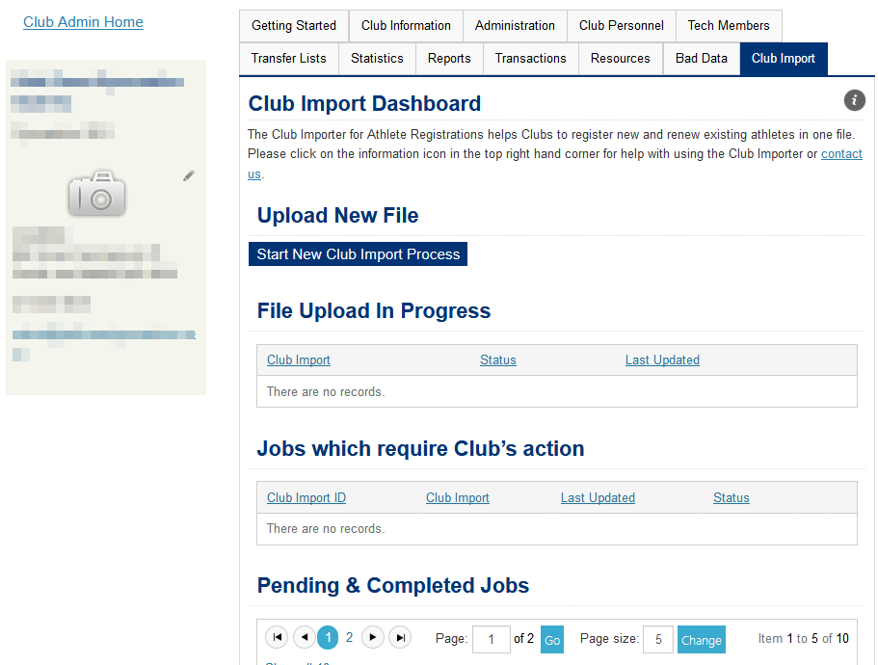
Step 1: Click on Start New Club Import Process Button

Slide 27
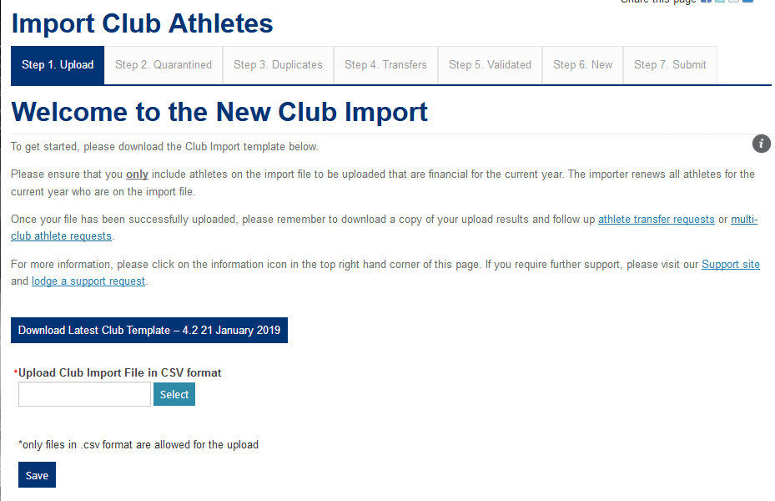
Step 2: Select CSV file to be imported
Click on the Select button to select a CSV file to import.
Please ensure that your file is ONLY a CSV (Comma delimited) (*csv) format file. You will have issues with other type of CSV formatted files being imported.

Slide 28
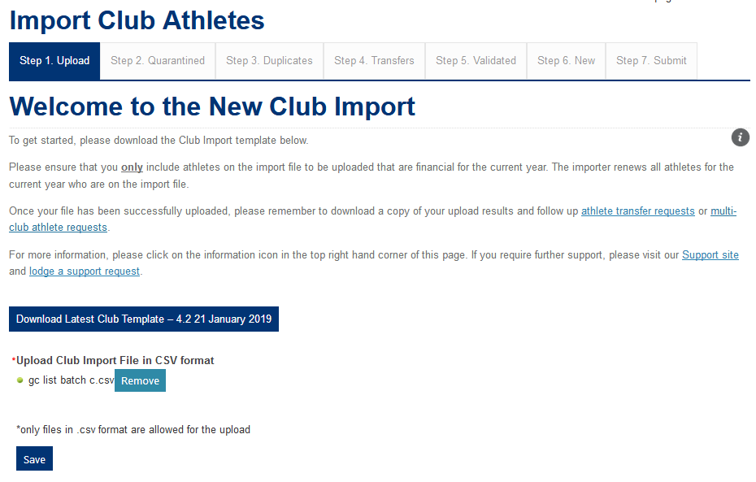
Step 3: Ensure file is acceptable & then click on Save button
If the file is acceptable you will see a green circle to the left of the file name. If not, please remove file and ensure you have selected a CSV (Comma delimited) (*.csv) file.
Please then click on the Save button to iniate the file upload process.

Slide 29
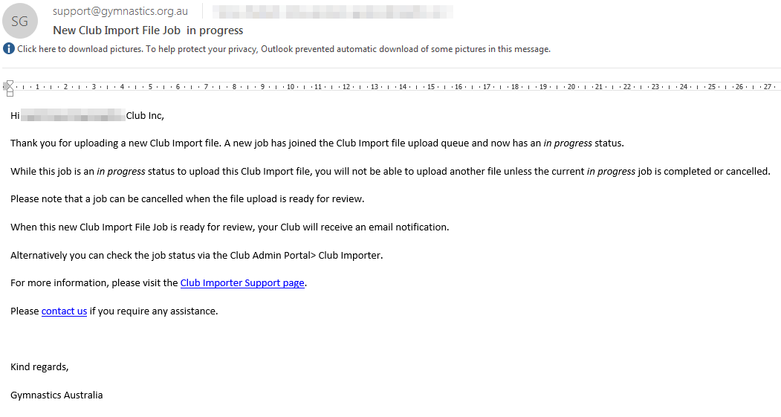
Step 4: Club Administrators will receive this notification when new file has commenced importing

Slide 30
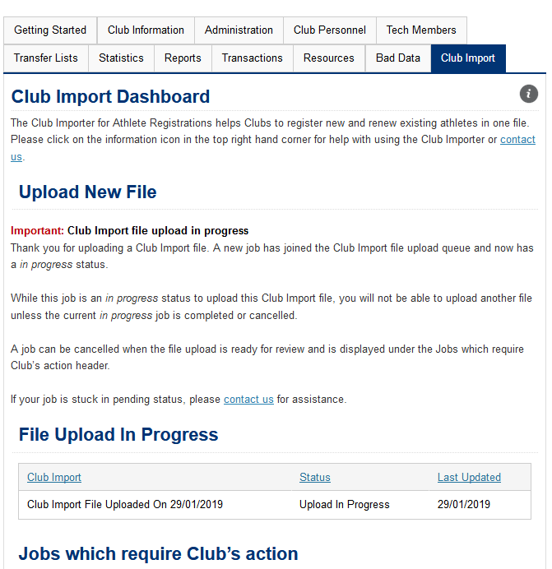
Step 5: Club Import file upload in progress
A Club Import file upload is now in progress.
All Club Administrators will see an onscreen notification and also receive an email notification when this file is ready to be reviewed.
Please note that records will not be written to the database at this stage.
While you see this message, your Club is unable to upload a new file.
Tip: Please click on the F5 page to refresh the page and see your import’s current status onscreen
This is where you can see that your file has an upload in progress status which means it is currently queued.

Slide 31
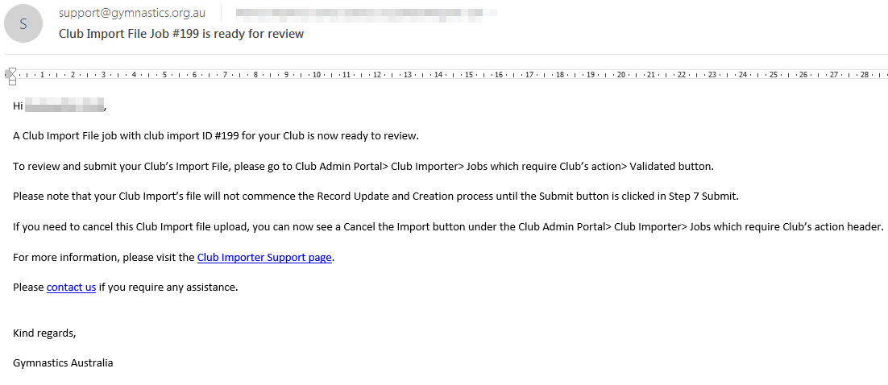
Step 6: Club Administrators receive email notification that File requires action

Slide 32
Step 7: Club Administrators also see onscreen alert to take action

Slide 33
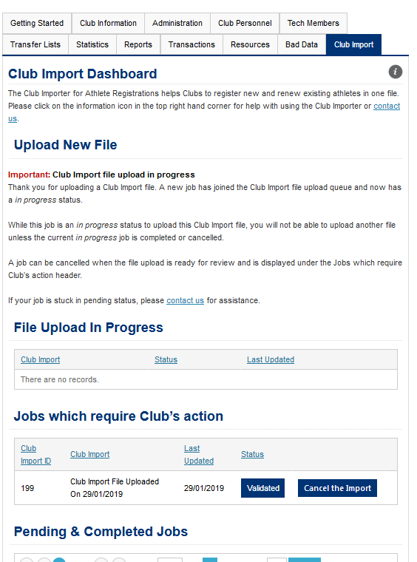
Step 8: Click on Validated Button
Your file upload is now ready to be actioned by your Club via Validated button. The records will not be written to the database at this stage.
This validation process can be done by any Club Administrator in your Club and can be done over a few login sessions
You can click on this button to cancel this import at this time.
Please take note of your Club’s Import ID as this is your job number which can be tracked

Slide 34
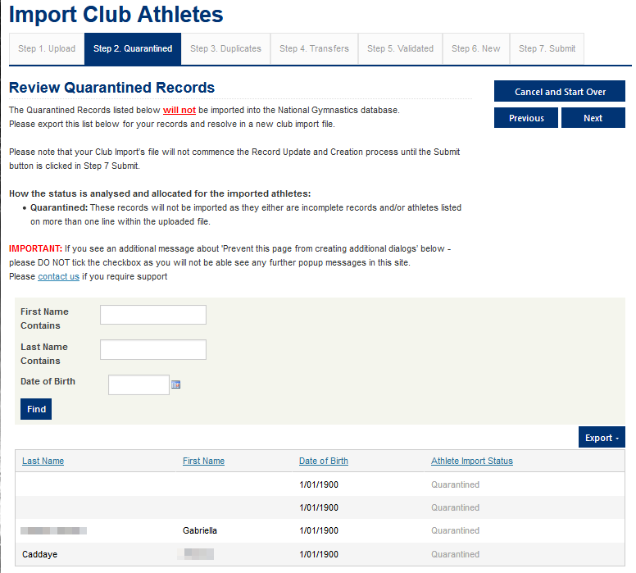
Step 9: Review Quarantined Records
Use this button if you need to cancel the import and start over
Use these buttons to move backwards and forwards through the records validation process
This is a filter you can use to sort through records in this list
Records in this list are quarantined as they either do not have a first name, last name or birthdate. These records will excluded from the import process and will NOT be updated in the database.
You can export this list to excel to resolve at a later time by your Club

Slide 35
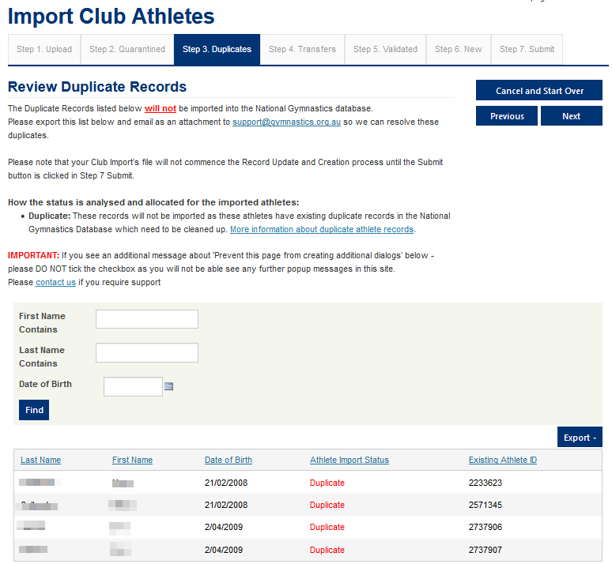
Step 10: Review Duplicate Athlete Records
Use this button if you need to cancel the import and start over
Use these buttons to move backwards and forwards through the records validation process
This is a filter you can use to sort through records in this list
Athletes with more than one name included on this list are duplicate records as these athletes have the same first name, last name and birthdate. The Club Importer does not know which records to update. These records will excluded from the import process and will NOT be updated in the database.
If you have an Athlete with only ONE name in this list, this means this athlete was listed more than one time on the import sheet and second listed record will not be imported.
We recommend exporting this list to excel and email this list to support@gymnastics.org.au to resolve these records

Slide 36
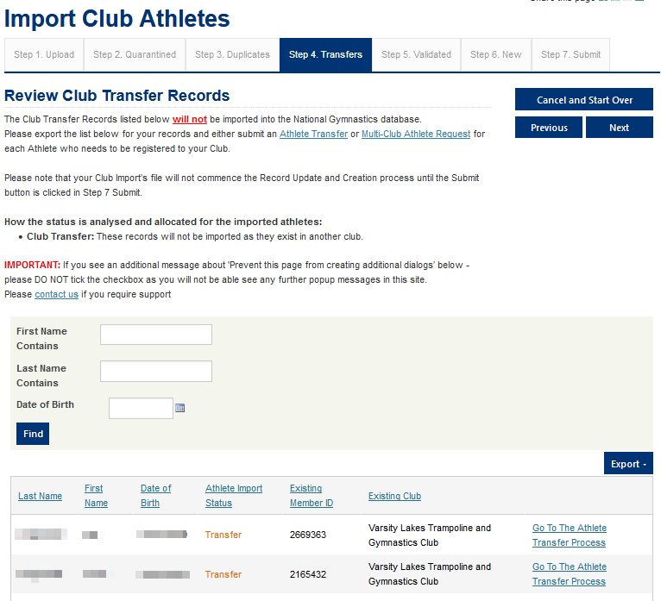
Step 11: Review Transfer Records
Use this button if you need to cancel the import and start over
Use these buttons to move backwards and forwards through the records validation process
This is a filter you can use to sort through records in this list
Records in this list are athletes who are registered at other Clubs and require either an Athlete Transfer or a Multi-Club Athlete Request. These records will excluded from the import process and will NOT be updated in the database.
You can export this list to excel to resolve at a later time by your Club

Slide 37
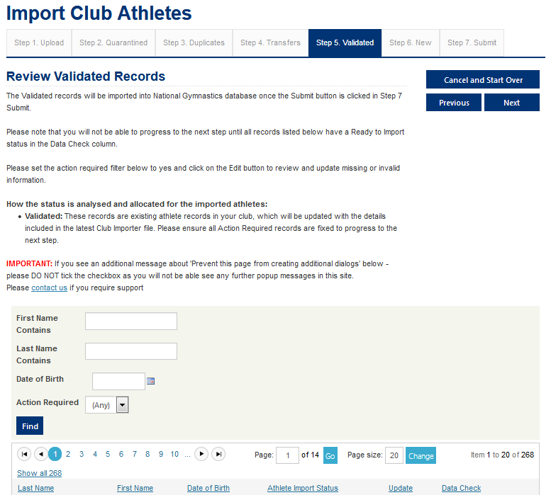
Step 12: Review Validated Records
Use this button if you need to cancel the import and start over
Use these buttons to move backwards and forwards through the records validation process. You will only be able to proceed to the next screen once all the Action Required records are resolved
This is a filter you can use to sort through records in this list. We recommend setting the Action Required filter to yes to work through resolving these issues to proceed to the next screen.
Records in this list are athletes who are already registered with your Club and will be renewed/updated. These records will be written to the database following the submit button being clicked in Step 7 Submit screen.
Please refer to the Data Check column in this list and fix any records which are marked as Action Required.

Slide 38
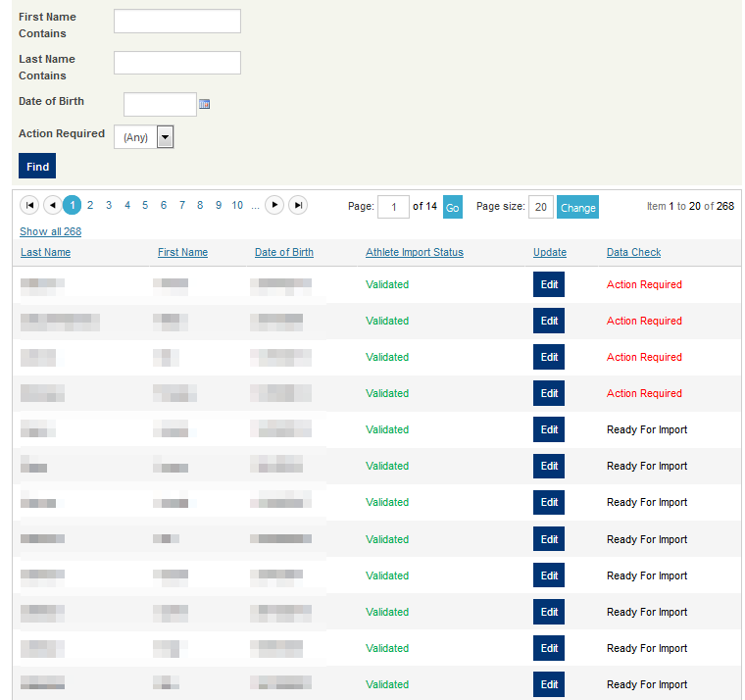
Step 12 (Continued): Review Validated records
Click the Edit button to review information relating to the record which can be edited/resolved
Records which are flagged as Action Required have issues with incomplete or invalid data which need to be resolved before proceeding to the next step.
Records which are flagged as Ready for Import have complete and valid data are acceptable for the import.

Slide 39
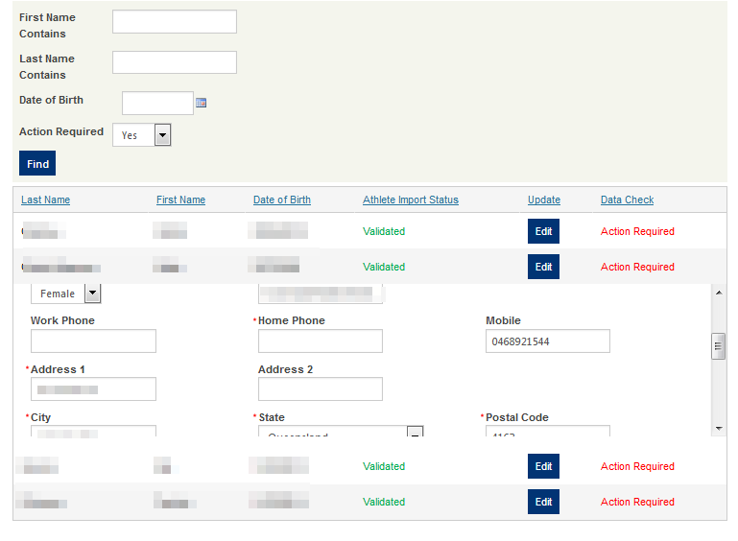
Step 13: Resolve Action Required records
We recommend setting Action Required filter to Yes to work through resolving records which are preventing your Club from submitting this file to be written to the National database
Click the edit button to see fields which relate to this record to fix the issue. More information on field requirements can be found here.
Once you have clicked the Edit button for a record which requires resolution you will see an error message which show what needs to be fixed – as a general rule all fields marked with a red asterisk should be valid and complete. More information on field requirements can be found here. In this example the Home Phone is missing and you could copy the mobile phone across to this field.
Once the issue(s) have been resolved, please scroll down this section and hit the save button (example next page

Slide 40
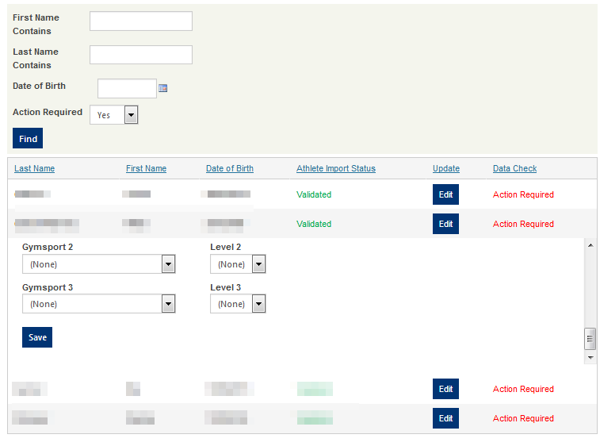
Step 13 (Continued): Resolve Action Required records
Save button is located here once you scroll down the section.
If the record has been resolved, it will change to having a Ready for Import data check status (or not be seen if you have the Action Required filter on).

Slide 41
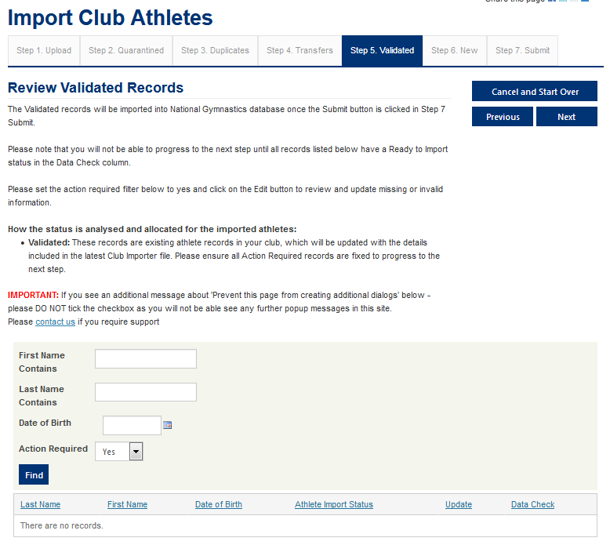
Step 14: Click on the Next Button to proceed to Step 6 New
Once all Action Required items have been changed to Ready to Import status, please click on the Next Button to proceed to Step 6 New tab

Slide 42
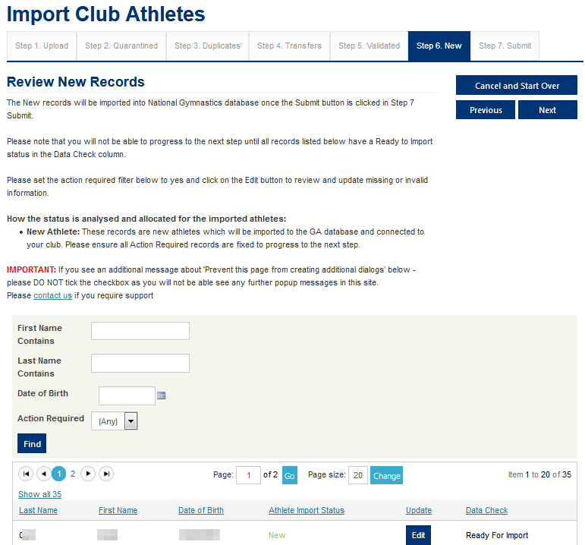
Step 15: Review & Fix New Records
Use this button if you need to cancel the import and start over
Use these buttons to move backwards and forwards through the records validation process. You will only be able to proceed to the next screen once all the Action Required records are resolved
This is a filter you can use to sort through records in this list. We recommend setting the Action Required filter to yes to work through resolving these issues to proceed to the next screen.
Records in this list are athletes who have not been registered with your Club (or any other Club) and will be created as a new record. These records will be written to the database following the submit button being clicked in Step 7 Submit screen.
Please refer to the Data Check column in this list and fix any records which are marked as Action Required (see Steps 13 to 14 in this pack for a process)
Tip: If all your athletes unexpectedly on this list as new, please check that you haven’t mixed up the first and last name fields or have a different birthdate. If so, please cancel and start over

Slide 43
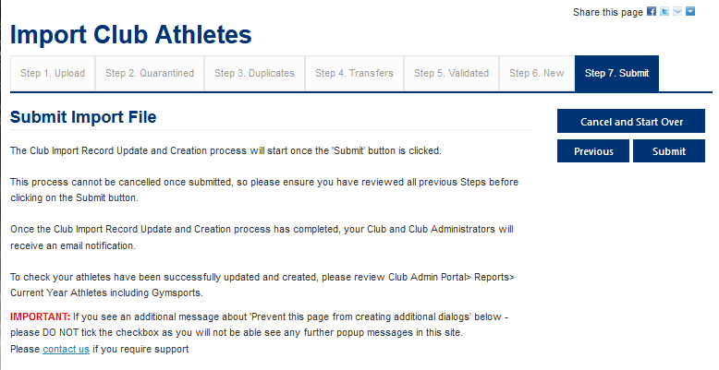
Step 16: Submit Import File to be written to the database
To iniate the validated records being written to the database, please ensure you have click on the submit button in Step 7.
This will queue this import file job’s validated records (In Step 5 Validated and Step 6 New) written to the database.
Your Club will receive email notifications about the process of this job.
Your Club will also be able to upload another file now (see Step 1)

Slide 44
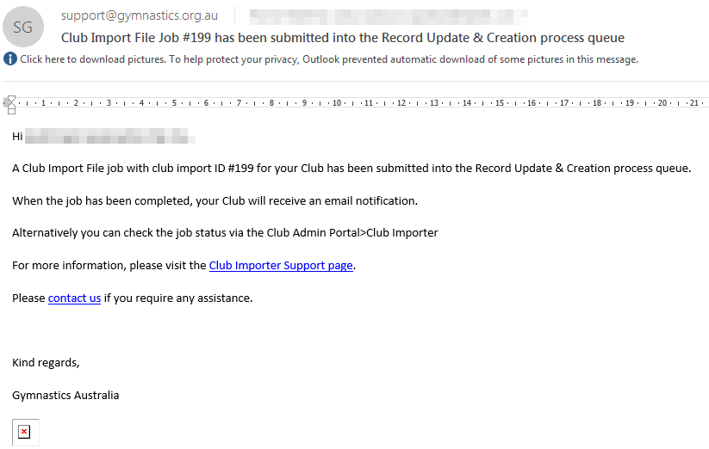
Step 17: Your Club’s Administrators will receive a notification that the job has been submitted into the Record Update & Creation queue

Slide 45
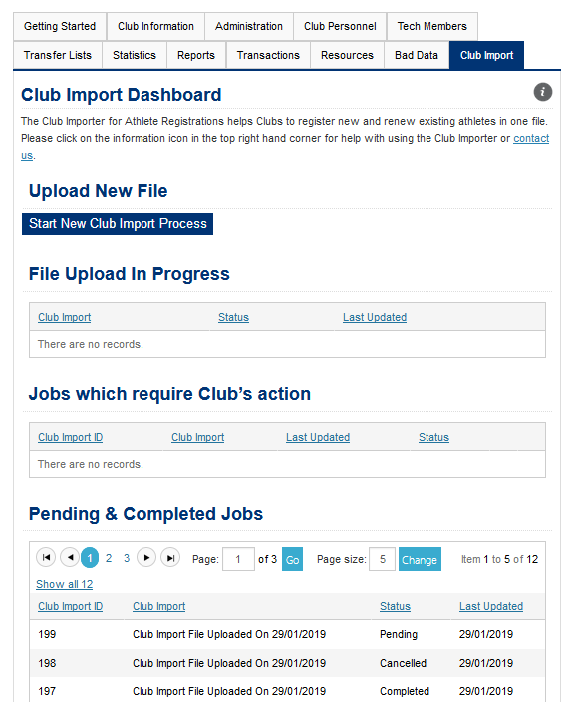
Step 18: Validated records are queued to be written to the database (depending on queue timing will fluctuate)
In Pending Status, your import job’s validated records have been queued to be written to the database.

Slide 46
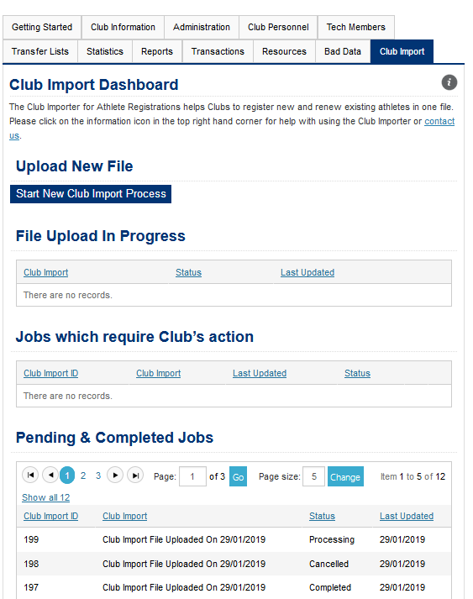
Step 19: Club Import Job status will change to Processing
In Processing Status, your import job’s validated records commenced being written to the database.

Slide 47
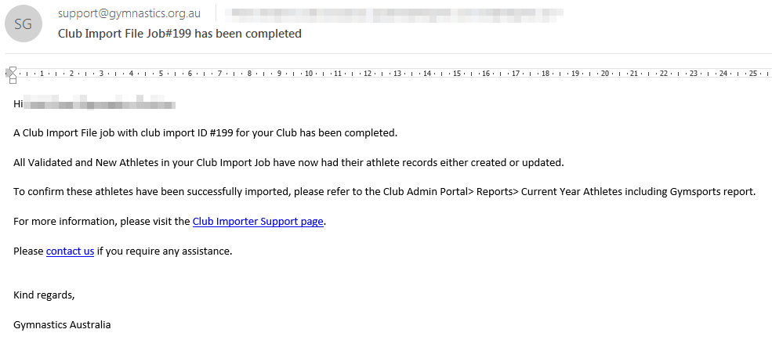
Step 20: Club’s Administrators receive notification that Job has been completed

Slide 48
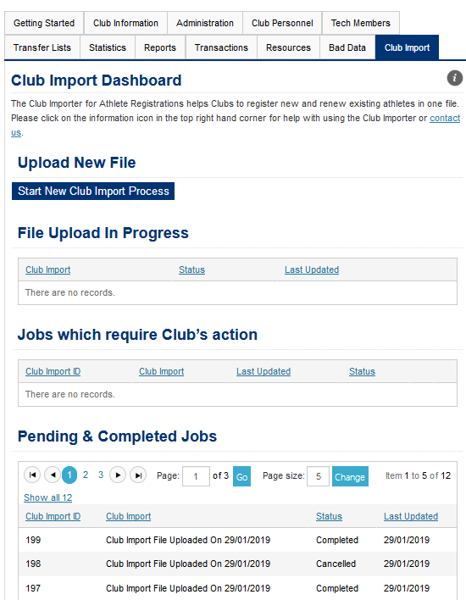
Step 21: Click on Start New Club Import Process Button
In Completed Status, your import job’s validated records have finished being written to the database.
You can now validate these records via Club Admin Home> Reports> Current Year Athletes including Gymsports report

Slide 49
Troubleshooting Error Messages & Failed Imports

Slide 50
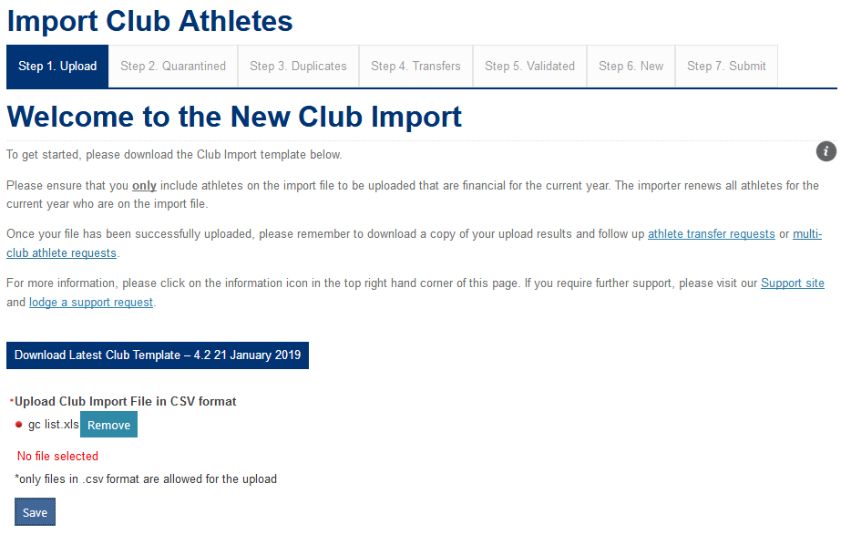
Unable to Upload Club Import file in Step 1. Upload
If you get a red dot and a No File selected message when you select the Save button, this means you are trying to upload a file which is not in the correct file format.
Please ensure you are using a file which is saved as a CSV (Comma Delimited) (*.csv) file type.
Important: Please do not use any other CSV file types as you will have issues with the import process.

Slide 51
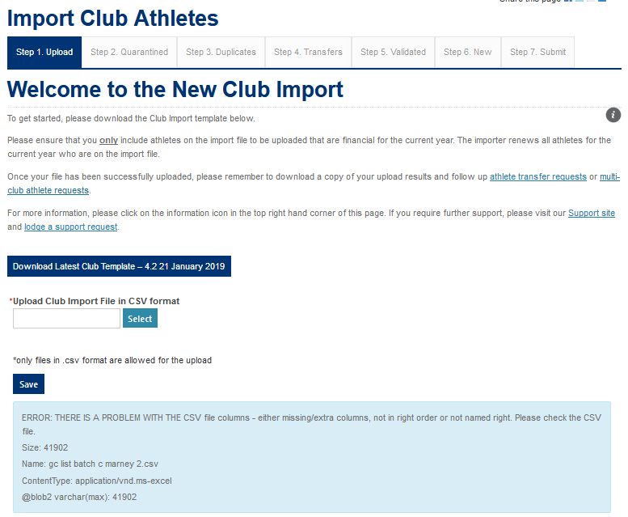
Getting Problem with CSV error in Step 1. Upload
You are trying to import a CSV file with the wrong headers. Please go to Club Import Report Requirements to check you are using the latest format.

Slide 52
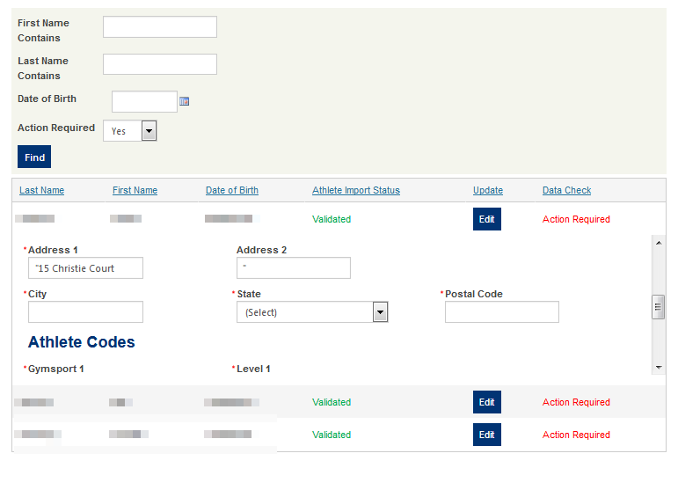
Import didn’t import all my information into Step 5 and 6 for some records
If you see an field which starts with “ and then no other expected fields being imported – this means that there was a comma in the record.
Commas are used to separate fields in CSV files and will result in any records not importing correctly and requiring to be fixed. More information on how you can do this in bulk in excel.
Alternatively please use the validation template as it will strip out all commas from your import file automatically.

Slide 53
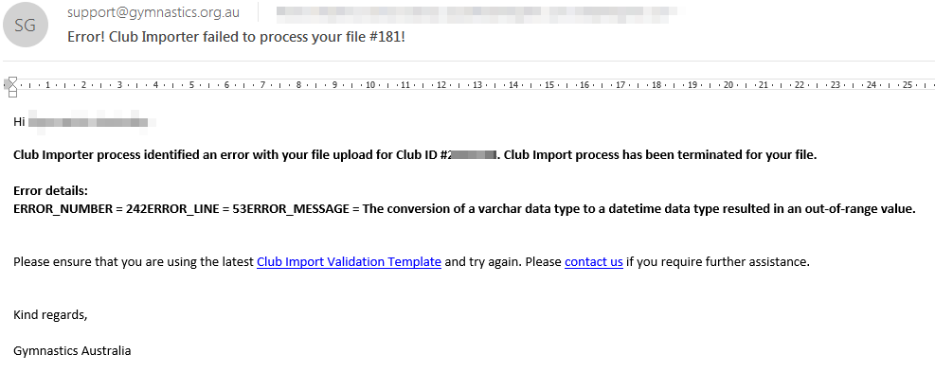
I got an email that my Club Import failed?
This import has failed as the dates were in American format eg. MM/DD/YYYY format.
To resolve update your import file with the correct format eg. DD/MM/YYYYY and start the import process again.
Please contact support@gymnastics.org.au if you require further assistance.

Slide 54
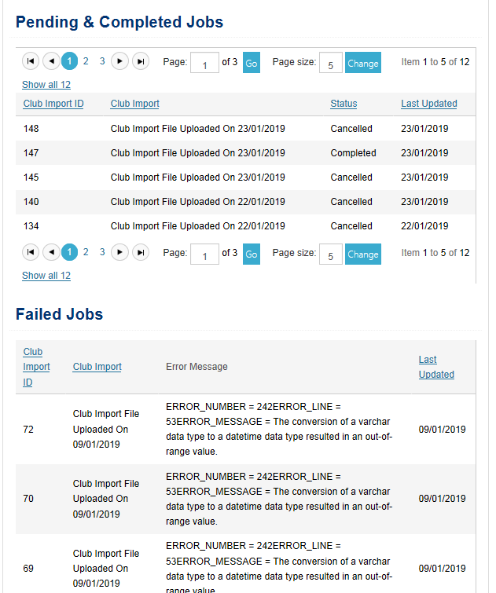
My Club Import dashboard says my import has failed?
This imports have failed as the dates were in American format eg. MM/DD/YYYY format.
To resolve update your import file with the correct format eg. DD/MM/YYYYY and start the import process again.
Please contact support@gymnastics.org.au if you require further assistance.

Slide 55
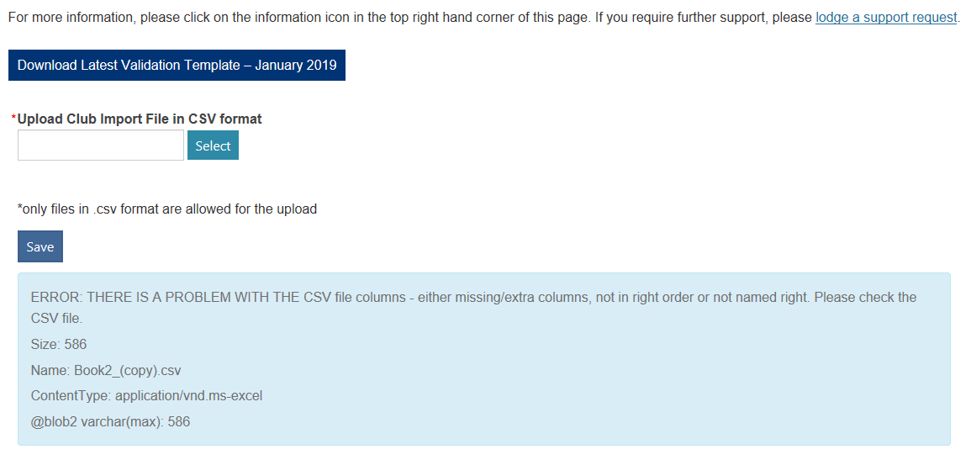
Error: There is a problem with the CSV file columns

Slide 56
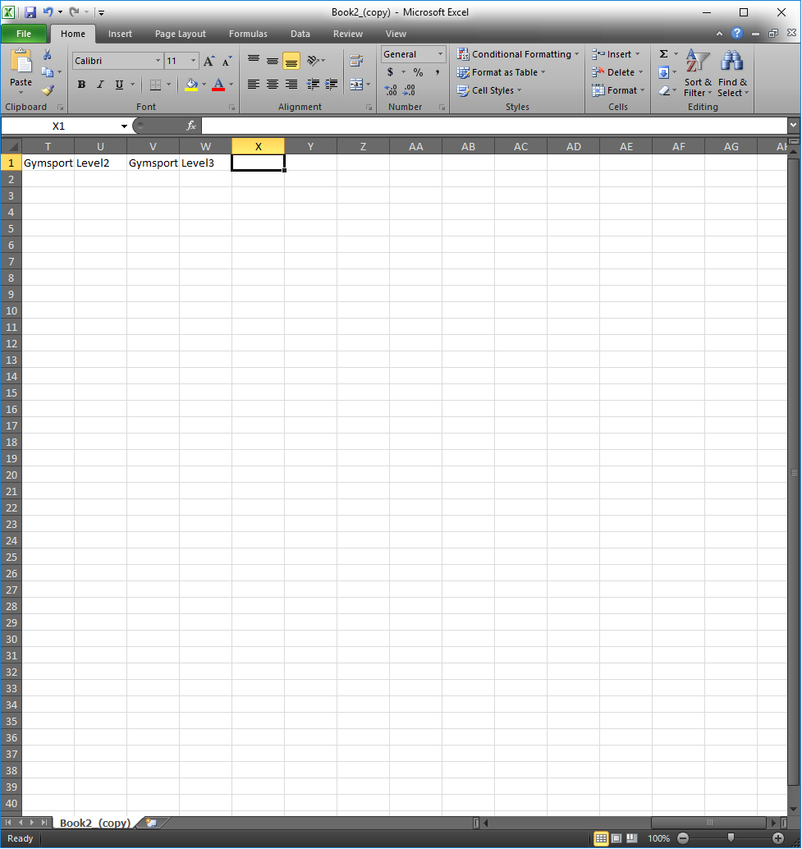
Error: There is a problem with the CSV file columns
ERROR: THERE IS A PROBLEM WITH THE CSV file columns - either missing/extra columns, not in right order or not named right.
Fix:
Navigate to cell X on the spreadsheet (the first blank column after Level3, the last column required in the sheet), and then click the top cell as pictured:

Slide 57
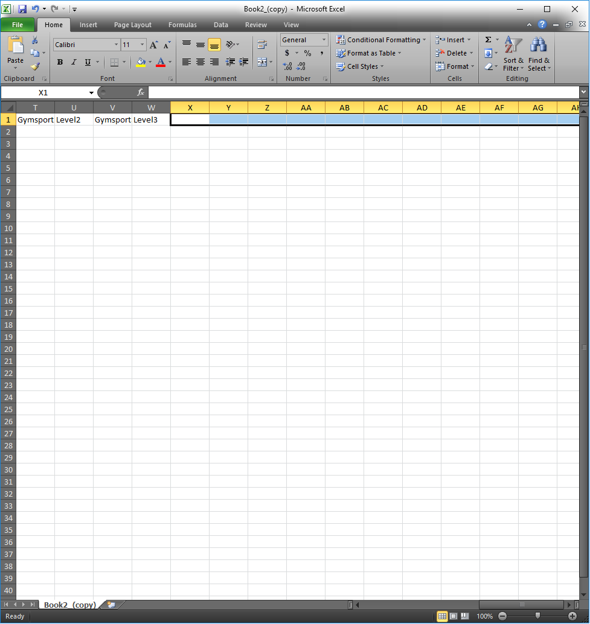
Error: There is a problem with the CSV file columns cont.
While selecting the top cell in X, press Ctrl+Shift+Right Arrow to extend the selection of cells to the last cell on the worksheet

Slide 58
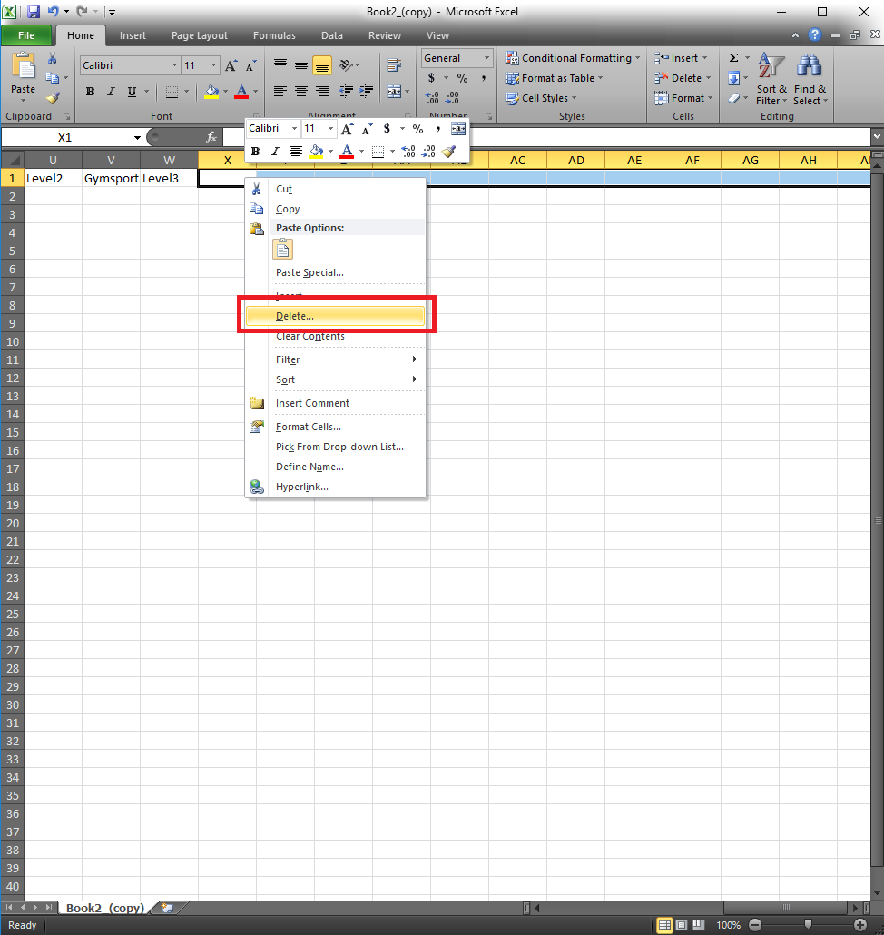
Error: There is a problem with the CSV file columns cont.
Right click on the top cell of X to open the context menu, and select “Delete”

Slide 59
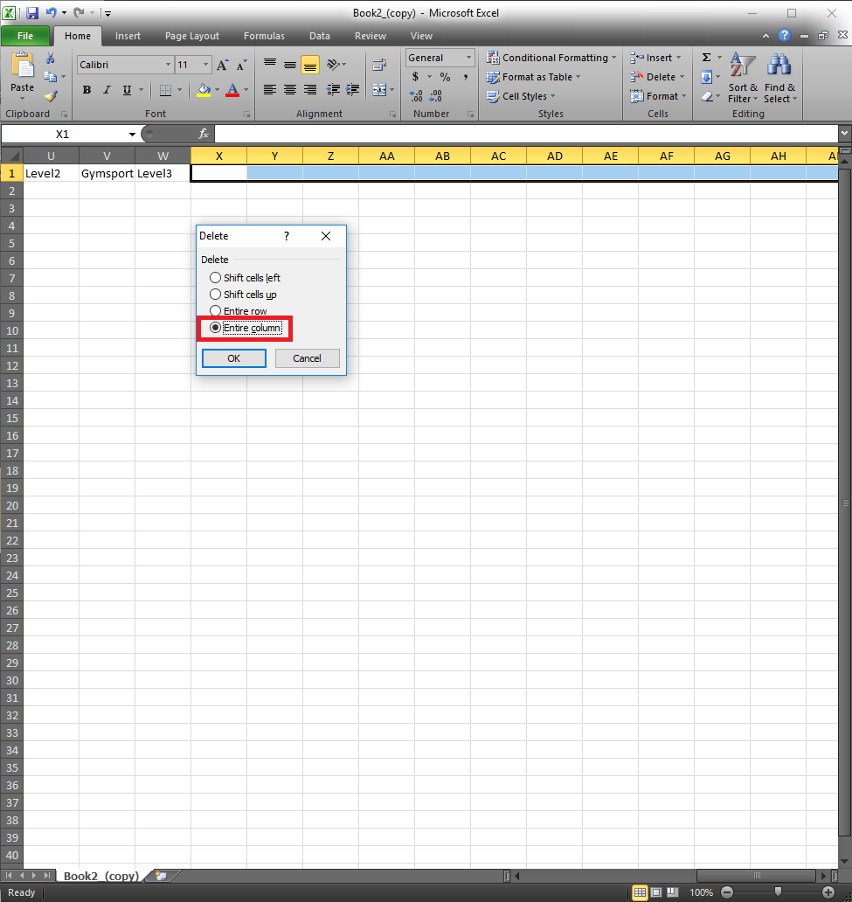
Error: There is a problem with the CSV file columns cont.
Select “Entire column”, then Click OK
What this does is it
removes any hidden
data in column header
cells.

Slide 60
How to access Club Import log for your Club

Slide 61
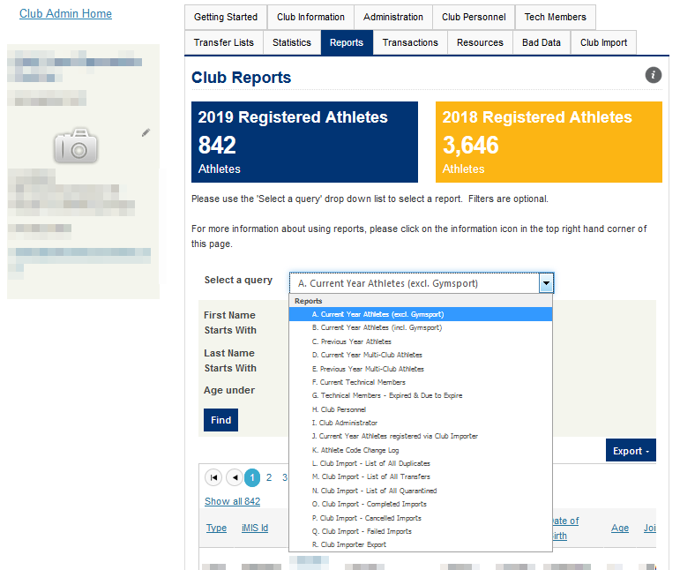
Go to Club Admin Home> Reports
J: Current Year Athletes registered via Club Importer
L: Club Import: List of all Duplicates
M: Club Import: List of all Transfers
N: Club Import: List of all Quarantined
O: Club Import: Completed Imports
P: Club Import: Cancelled Imports
Q: Club Import: Failed Imports
R: Club Importer Export (see other section in this pack)

Slide 62
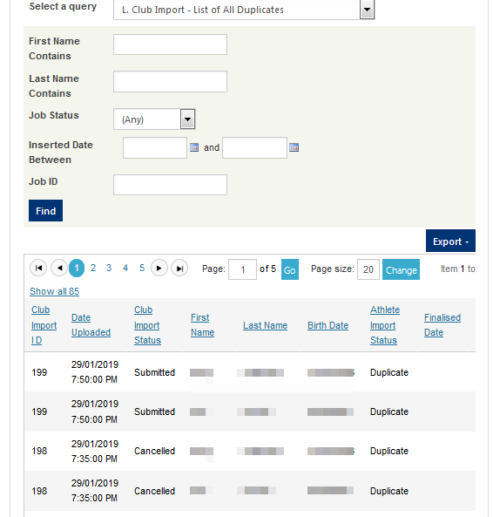
Club Import: Duplicates log
This is a log of duplicates which were not updated by the Club Import uploads for your Club as the Club Importer did not know which record to update.
Duplicates are either one of two scenarios:
Duplicate records with the same first and last names and birthdate in the databse
OR a duplicate record in your import sheet
These records must be cleaned up by the GA Support team to prevent any further issues.
Please raise a support ticket to support@gymnastics.org.au and attached this list so these duplicates can be resolved and registered.
More information on duplicates.
Please note the duplicate log will show all duplicates picked up with the club import process regardless of if they are resolved or not. This log resets at the end of each year.

Slide 63
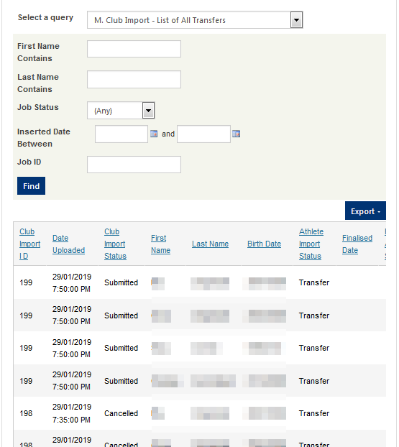
Club Import: Transfer Log
This is a log of transfer records which were not updated by the Club Import uploads for your Club as they are registered at another club and you must request either an athlete transfer or a multi-athlete to register this athlete with your club.
Please note the Transfer log will show all duplicates picked up with the club import process regardless of if they are resolved or not. This log resets at the end of each year.

Slide 64
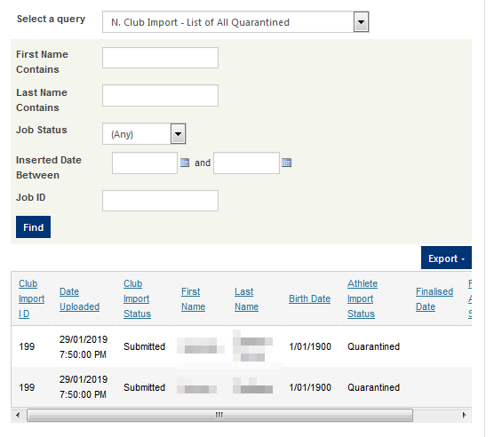
Club Import: Quarantined Log
This is a log of quarantined records which were not updated by the Club Import uploads for your Club as they were missing either a first name, last name or birthdate.
Please note the Quarantined log will show all duplicates picked up with the club import process regardless of if they are resolved or not. This log resets at the end of each year.

Slide 65
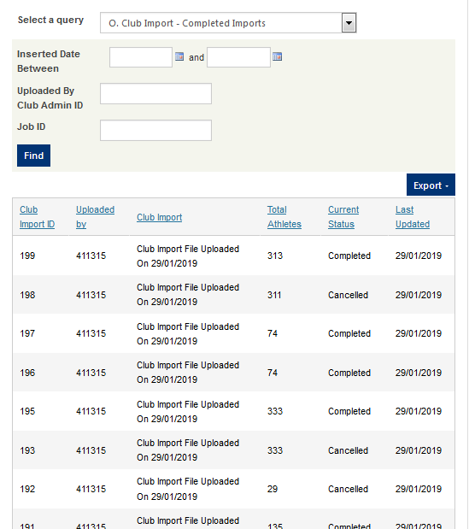
Club Import: Completed Imports Log
This is a log of completed or cancelled import jobs.
This log resets at the end of each year.

Slide 66
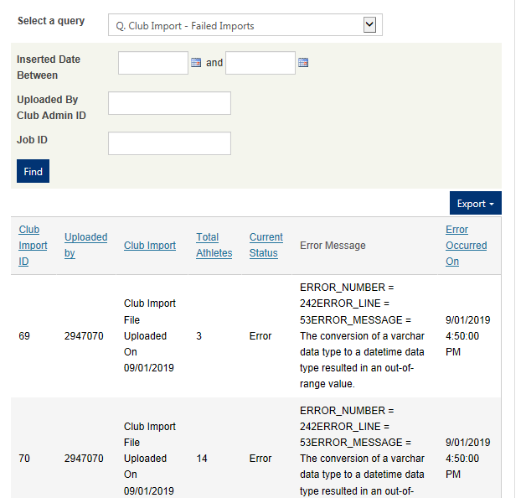
Club Import: Failed Imports Log
This is a log of failed import jobs and their reason. These jobs have not been successfully imported and you will need to start over again.
This log resets at the end of each year.

Slide 67
What if I need an athlete registered urgently?

Slide 68
What if I need an athlete registered urgently?
If you require an athlete registered urgently, the Club Import method may not be the best approach as your imports are queued and timing will depend on system demand.
If you require an athlete registered, renewed or updated urgently we recommend you either:
Existing athlete in your Club: Use the Bulk Renew
New athlete for your Club: Register the Athlete Individually via the Add or Transfer an Athlete button

Slide 69
Need Help?

Slide 70
Need more help?
Please visit: https://support.gymnastics.org.au/article/171-club-importer
Alternatively please submit a support request via https://support.gymnastics.org.au/conversation/new/7 or support@gymnastics.org.au
Please remember to attach any relevant files or screenshots to help us resolve your issue.

