Slide 1
Online Club Affiliation Renewals Process
January 2024

Slide 2
Contents
Online Club Affiliation Renewals
Process Overview
Club Admin Process
State Association Process
Help & Feedback Resources

Slide 3
Club Admin Process
Online Club Affiliation Renewals
Club Admin Process

Slide 4
Online Club Affiliation Renewal Process

Slide 5
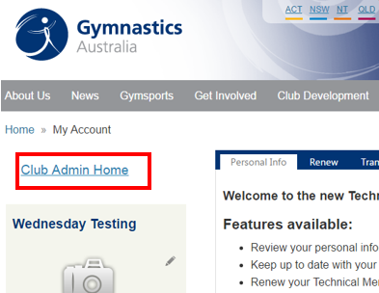
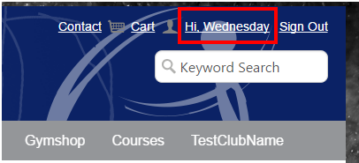
Logging into the Club Admin Portal as a Club Admin
Log onto GOL (https://imis.gymnastics.org.au/ )
Select the link in the top right hand corner Hi, <Your Name>
A new My Account page will appear. Select the Club Admin Home link on the left hand side of the page.

Slide 6
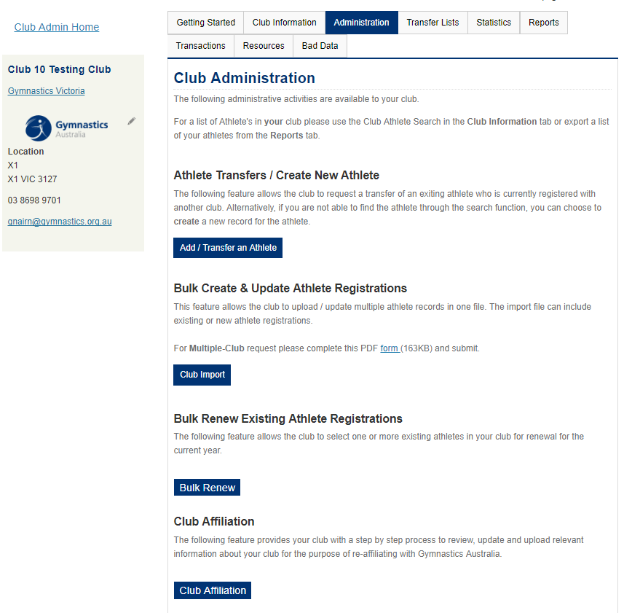
Accessing the Club Affiliation Form
Click on the Administration tab
Click on the Club Affiliation Button
This will take you to the Club Affiliation Renewals form.

Slide 7
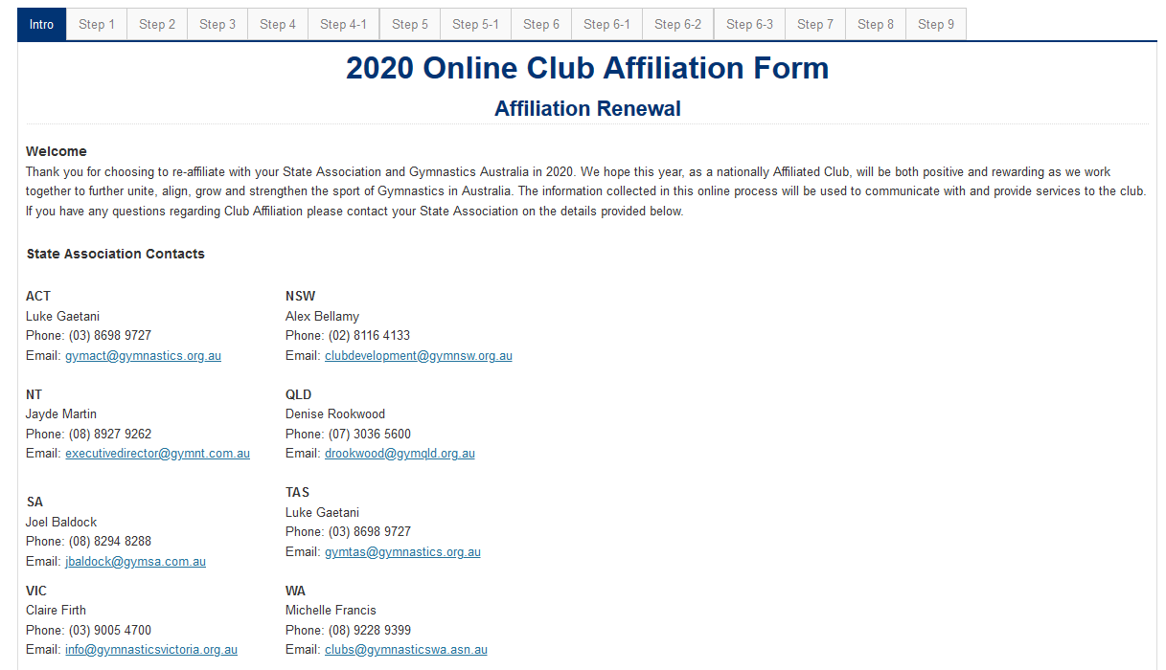
Introduction Page (Top of Page)
Users are unable to use top navigation unless going back to a previous page
Scroll down page for more instructions about completing form

Slide 8
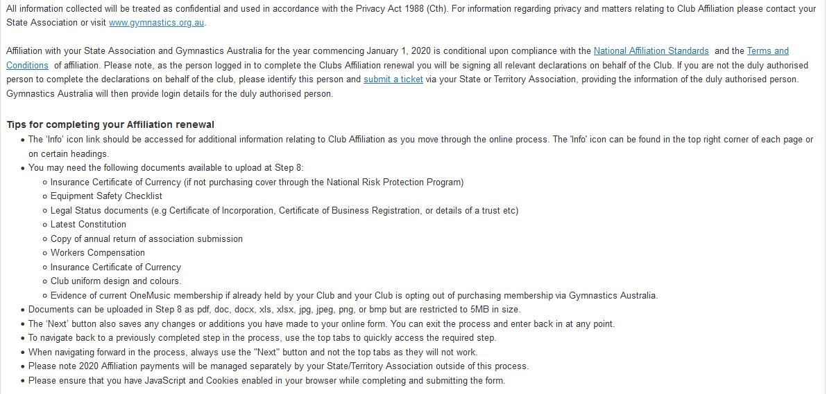
Introduction Page (Scroll to bottom of Page)
Important information to read

Slide 9
Step 1 | Club Information (Top of Page)
Click here for help
Details about your club that will appear on the Club Finder
Please choose most appropriate choice from the drop down list
Please leave blank if your club does not have a constitution

Slide 10
Step 1 | Club Information (Scroll to bottom of Page)
Please contact your State or Territory association if you need this updated
Important to Note about Previous / Next Buttons:
Previous Button will not save any changes on this page.
Next Button will save changes made on this page.
Please note that Supporting documentation is now uploaded in Step 8

Slide 11
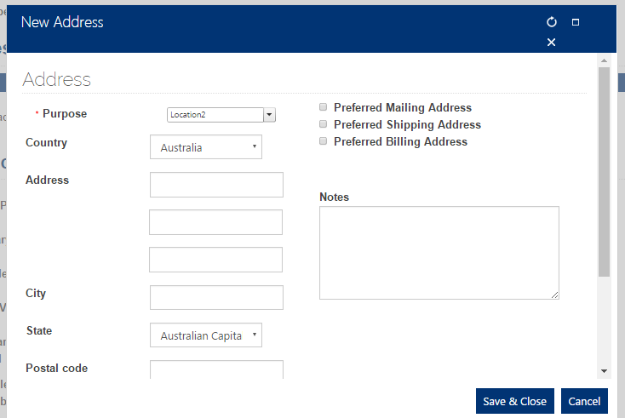
Step 2 | Venue Details (Top of Page)
To add new locations please select the + and then complete the information in the pop up window
Please click here for help
Update primary club address using this icon
Please only add email addresses here separated by a ; which you want the national club newsletter to go to

Slide 12
Step 2 | Venue Details (Scroll to Bottom of Page)
This field needs to be manually entered and will not automatically calculate
Supporting documentation is now uploaded in Step 8. Please follow the link provided for a template.

Slide 13
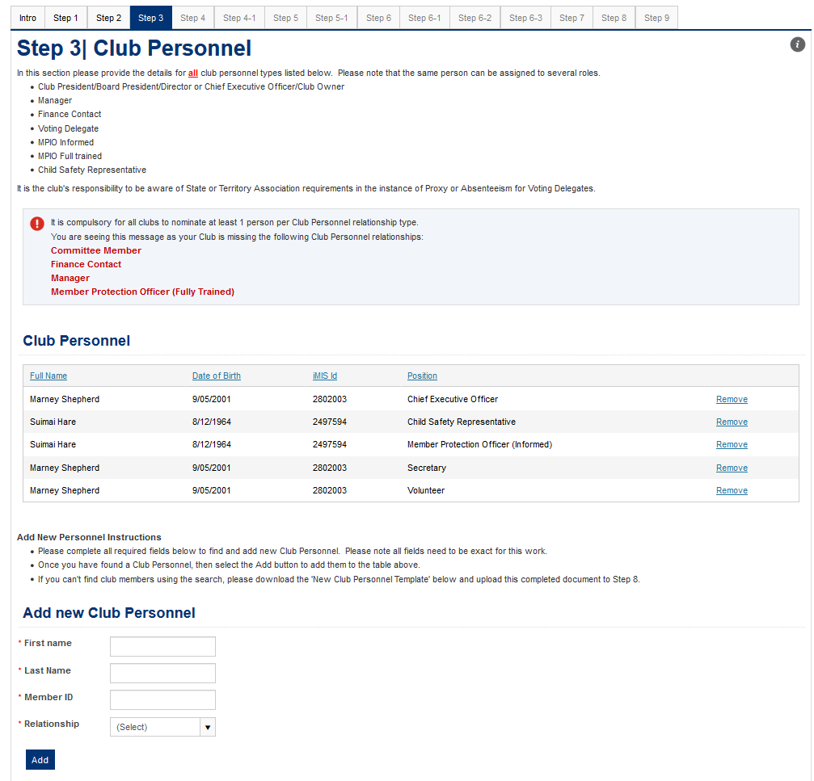
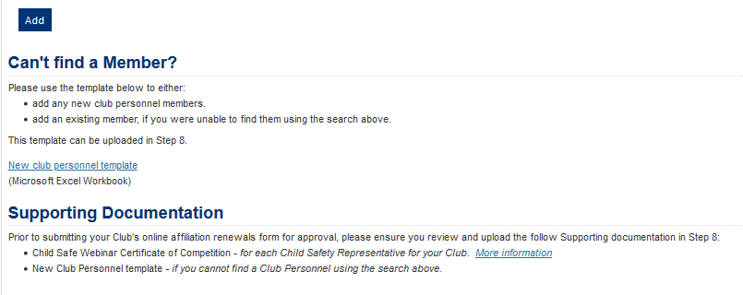
Step 3 | Club Personnel
Please click here for help
You will see an alert if you are missing mandatory club personnel contacts in your club. Please hit F5 (refresh) once you have updated this information to clear this message.
To sort this list, please click on the row headers
To remove an old club personnel member, please click on the Remove link
All details in all fields are required to add a new Club Personnel into the form.
If you can’t find the person you are looking for in the search, please download the template in the link provided, complete all details and upload in Step 8.

Slide 14
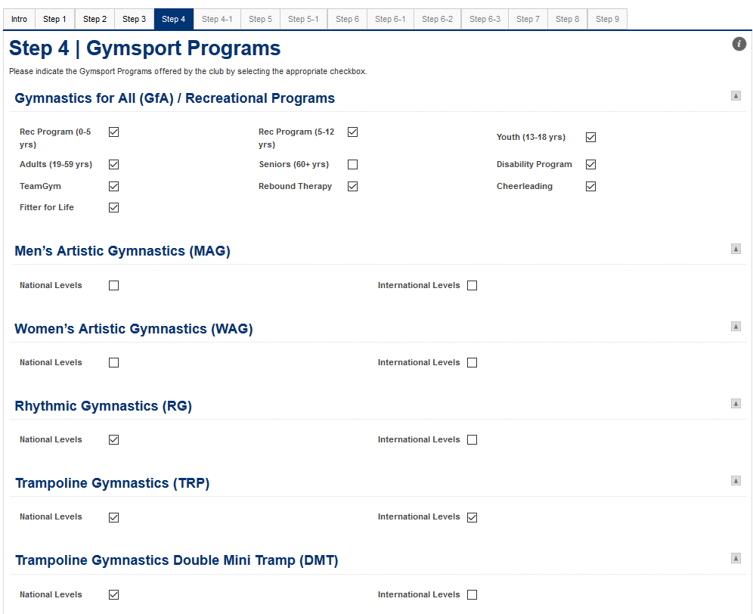
Step 4 | Gymsport Programs (Top of Page)
Please click here for help
Tick all gymsport choices which apply to the club as this will reflect on the club finder
Scroll down page for more choices

Slide 15
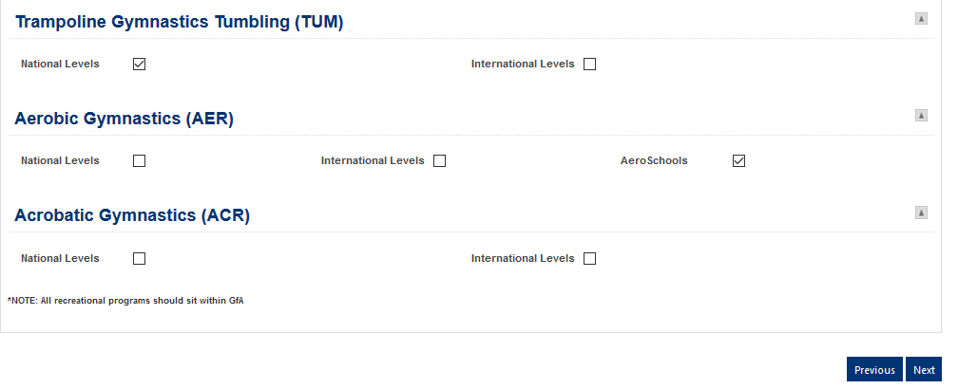
Step 4 | Gymsport Programs (Scroll to bottom of Page)
Tick all gymsport choices which apply to the club as this will affect the club finder

Slide 16
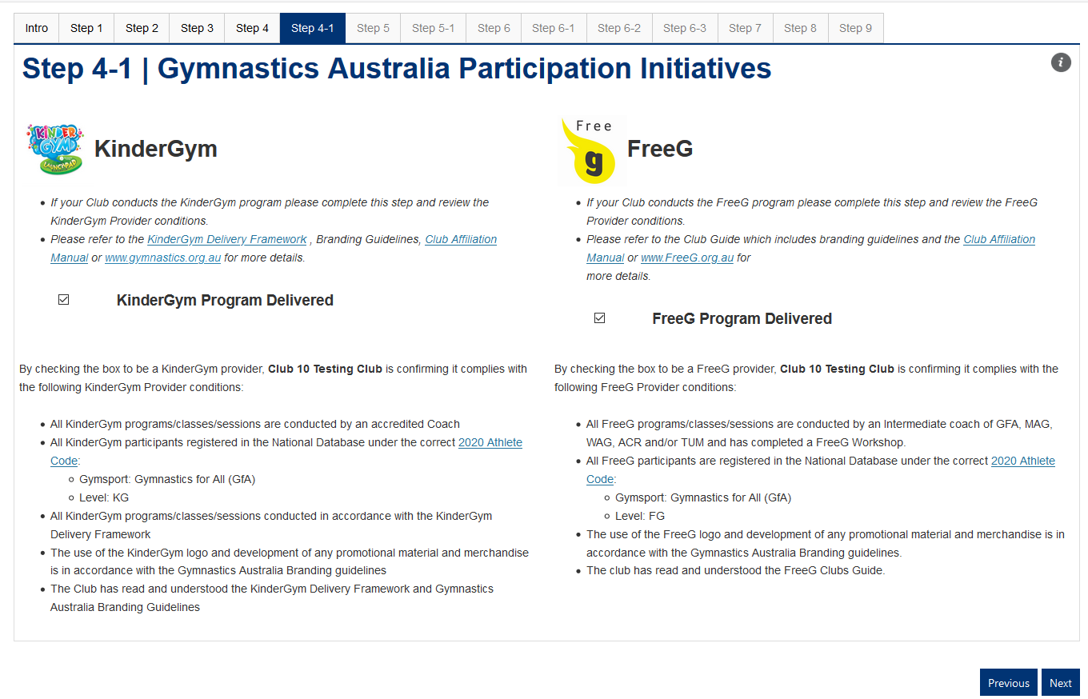
Step 4-1 | Gymnastics Australia Participation Initiatives
Please click here for help
Please check boxes if the KinderGym or FreeG Programs are being delivered by the Club

Slide 17
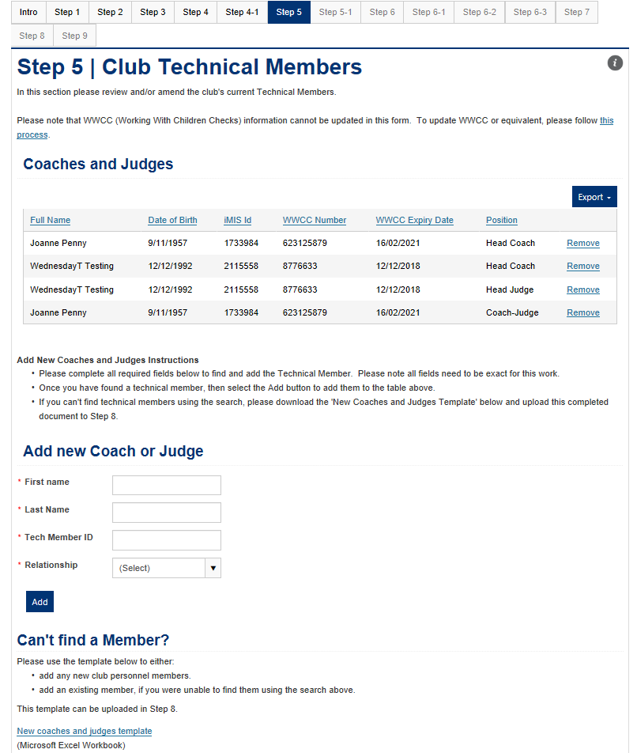
Step 5 | Club Members
Please click here for help
To sort this list, please click on the row headers
To remove an old club personnel member, please click on the Remove link
All details in all fields are required to add a new Club Personnel into the form.
If you can’t find the person you are looking for in the search, please download the template in the link provided, complete all details and upload in Step 8.

Slide 18
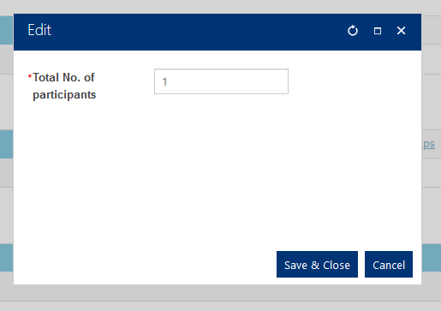
Step 5-1 | Participation Members
Please click here for help
Please click on pencil icon to add statistics for your club to the form
Please click here for help

Slide 19
Step 6 | Insurance
Please click here for help
Depending on your selection, your club will only see either 6-1 Insurance Opt-Out Page or 6-2 Insurance Opt-In page after you select the Next button on this page.
Also please allow the next page to fully load as there may be a lag with this functionality.

Slide 20
Step 6-1 | Insurance Opt In
Please click here for help
Supporting documentation is now uploaded in Step 8.
Next button will be available when the club declaration is checked

Slide 21
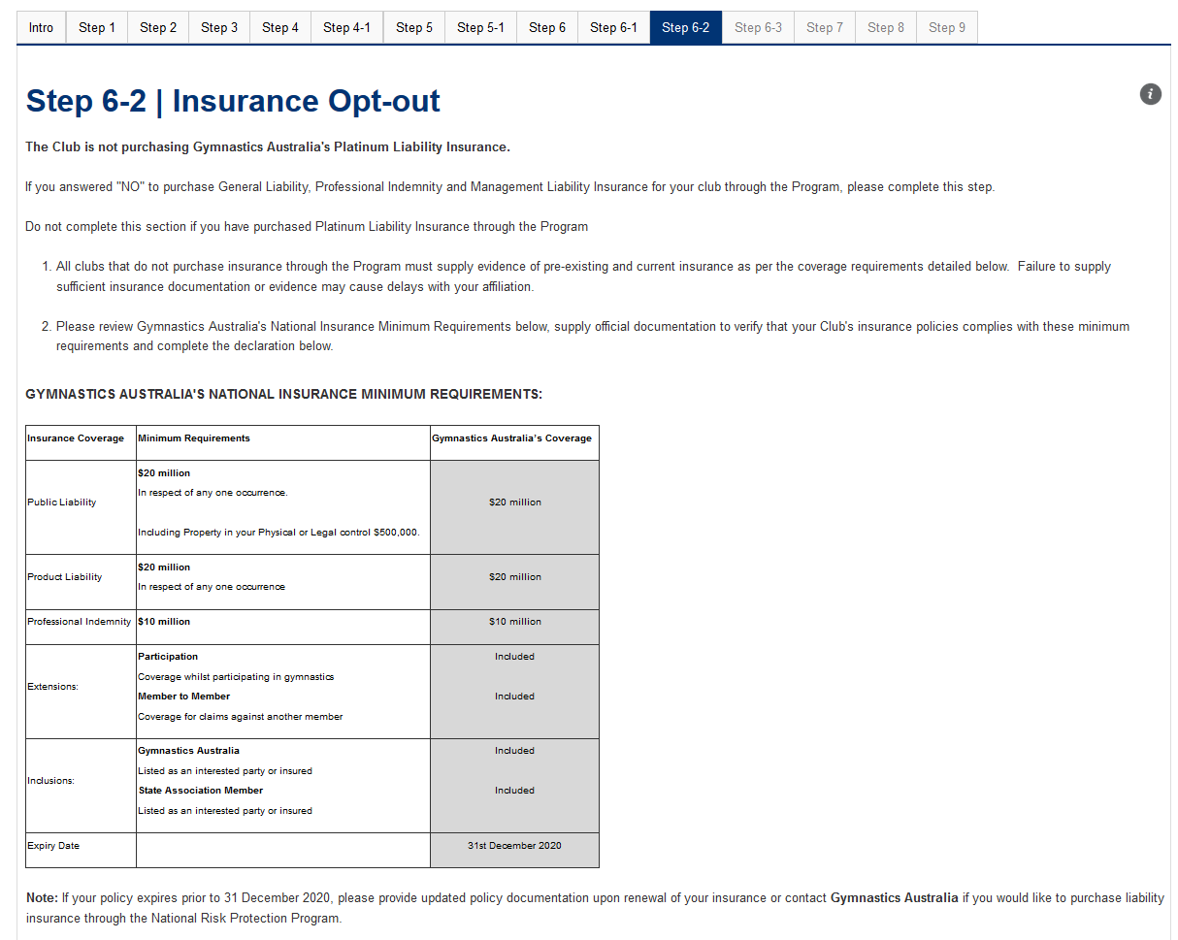
Step 6-2 | Insurance Opt-Out (Top of Page)
Please click here for help
Scroll down page

Slide 22
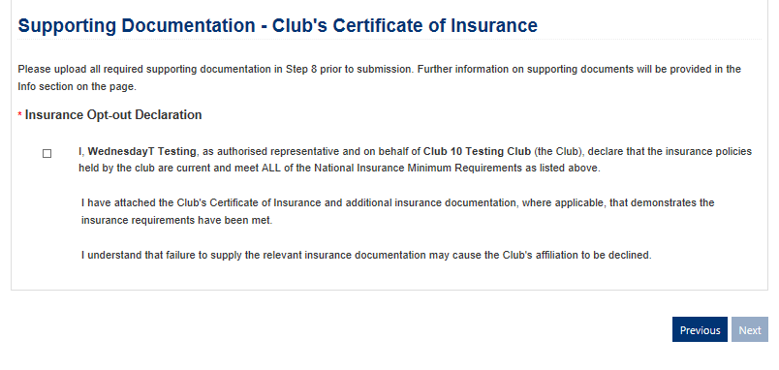
Step 6-2 | Insurance Opt-Out (Bottom of Page)
Supporting documentation is now uploaded in Step 8.
Next button will be available when the insurance opt-out declaration is checked

Slide 23
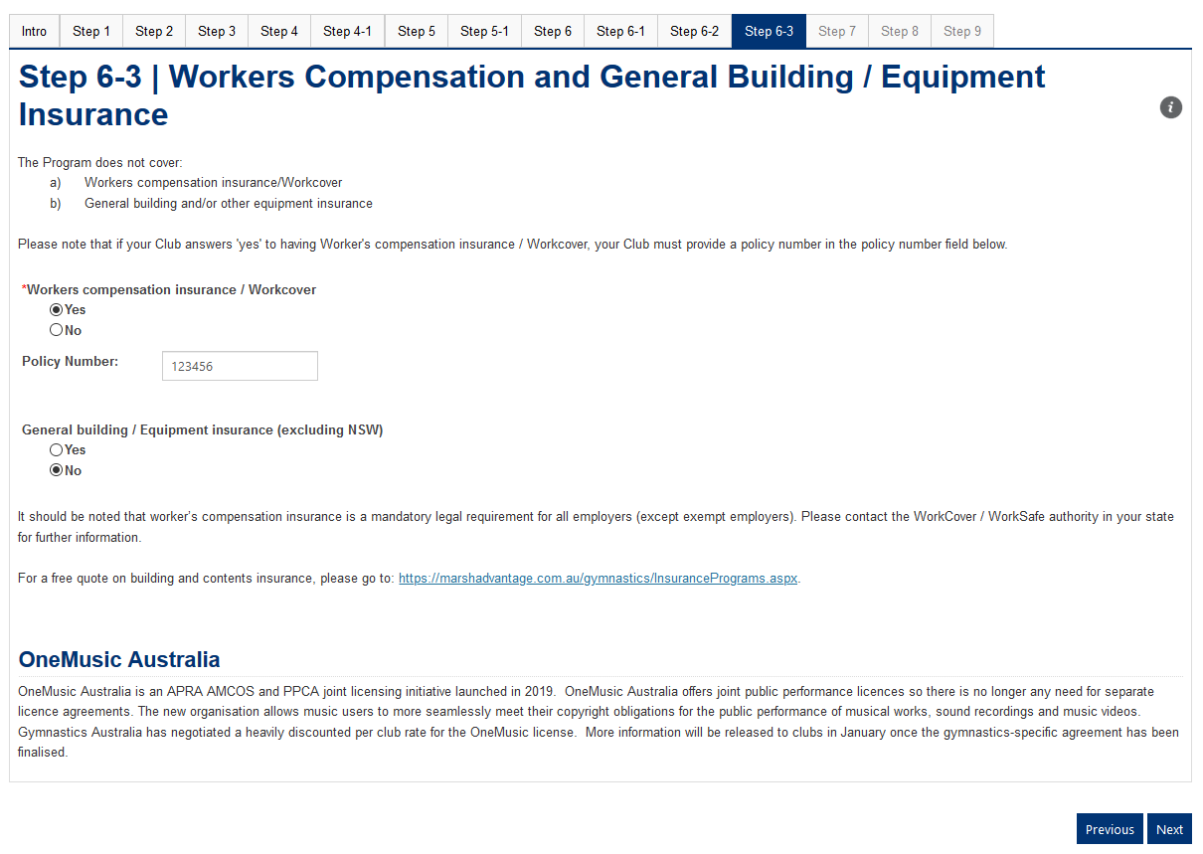
Step 6-3 | Workers Compensation & General Building / Equipment Insurance / Music Licences
Please click here for help
If yes is selected, you must write the policy number in the field below.
OneMusic Licence opt in will be available later in January 2020. This is not available currently.

Slide 24
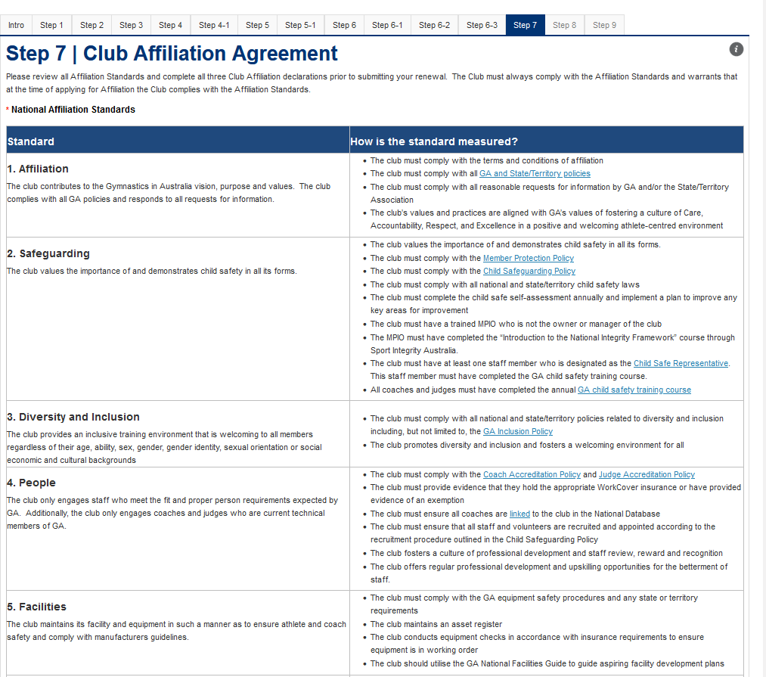
Step 7 | Club Affiliation Agreement (top of page)
Please click here for help
Scroll down page

Slide 25
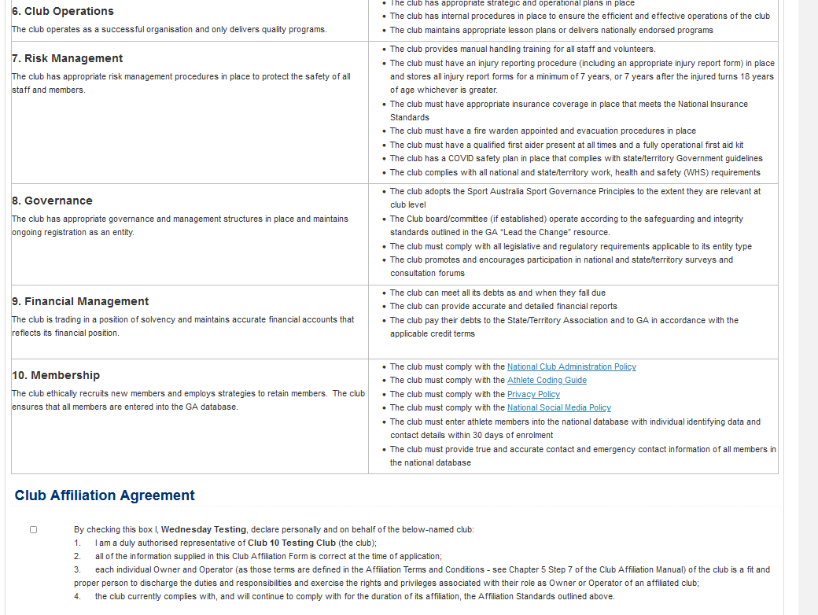
Step 7 | Club Affiliation Agreement (middle of page)
Scroll down page

Slide 26
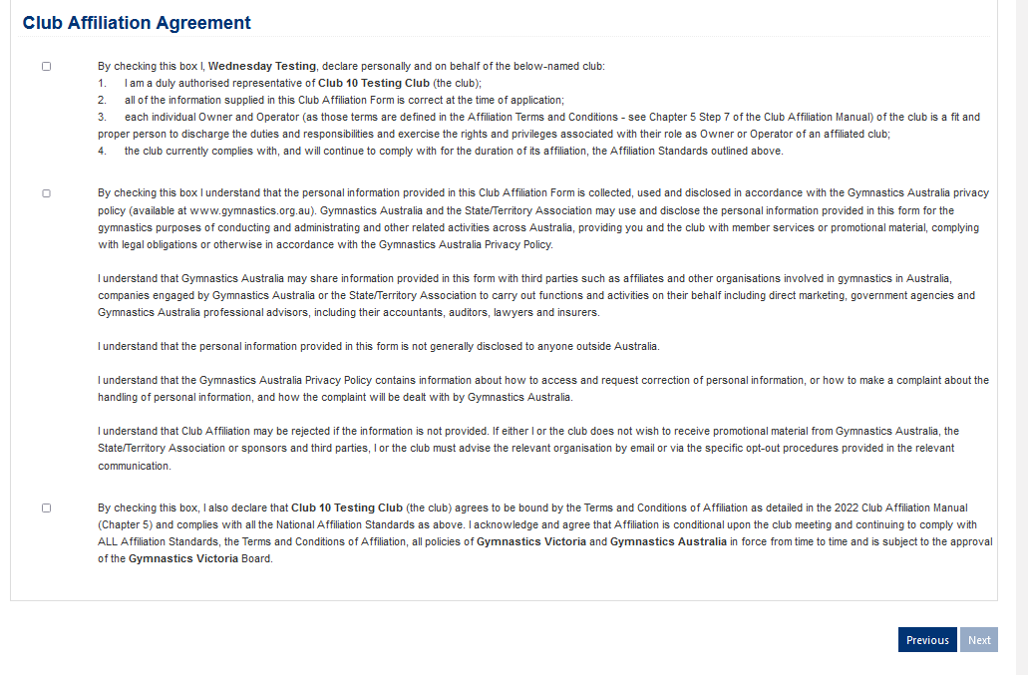
Step 7 | Club Affiliation Agreement (bottom of page)
Next button will be available when all agreements have been checked

Slide 27
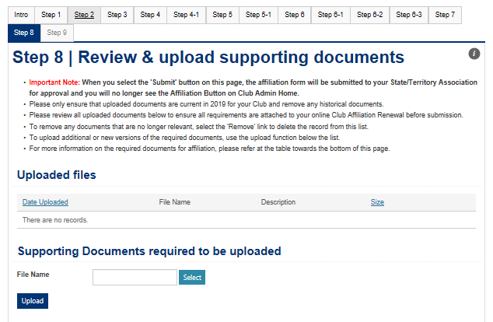
Step 8 | Review & Upload supporting documents (top of page)
Please click here for help
Sort the list by clicking on the row headers
Please click on the links to download or remove a document
Scroll down page
Upload documents here

Slide 28
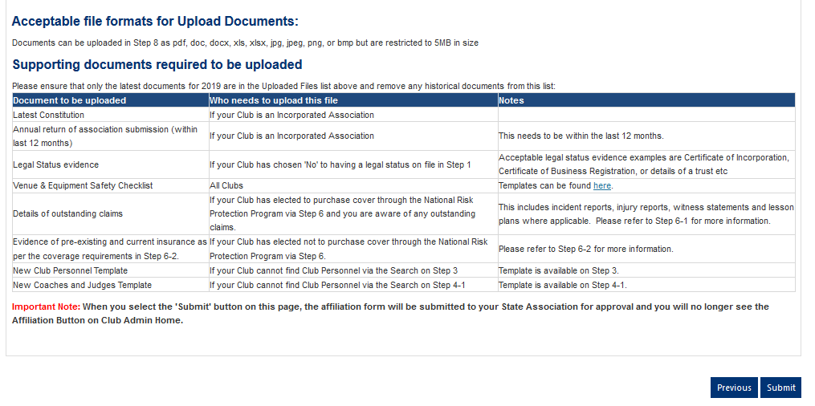
Step 8 | Review & Upload supporting documents (bottom of page)
Info about what needs to be uploaded.
This Submit Button will trigger an email confirmation and for the application to be in pending approval state for State Associations.

Slide 29
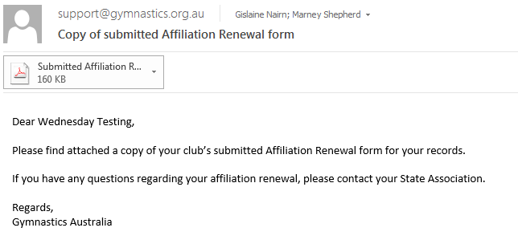
Email Confirmations

Slide 30
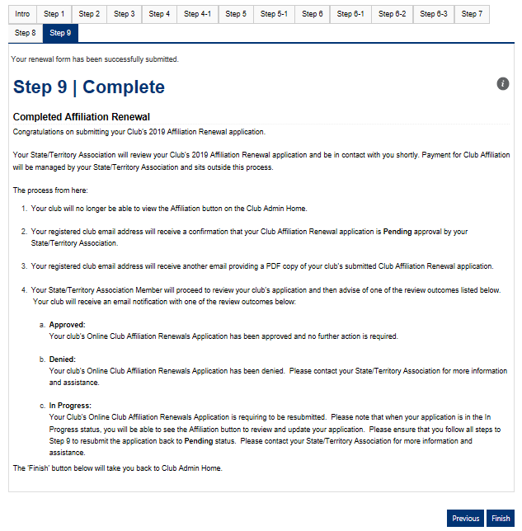
Step 9 | Complete
The Finish Button will return the user to the Club Admin Portal home page.

Slide 31
What is the Process from here?
Once you have completed the Online Affiliation form:
Your club will no longer be able to view the Affiliation button on the Club Admin Home.
Your registered club email address will receive a confirmation that your Club Affiliation Renewal application is Pending approval by your State Association.
Your registered club email address will receive another email providing a PDF copy of your club’s submitted Club Affiliation Renewal application.
Your State Association Member will proceed to review your club's application and then advise of one of the review outcomes below. You will receive an email notification with one of the review outcomes below:
Approved: Your club's Online Club Affiliation Renewals Application has been approved and no further action is required.
Denied: Your club's Online Club Affiliation Renewals Application has been denied. Please contact your State Association for more information and assistance.
In Progress: Your Club's Online Club Affiliation Renewals Application is requiring to be resubmitted. Please note that when your application is in the In Progress status, you will be able to see the Affiliation button to review and update your application. Please ensure that you follow all steps to Step 9 to resubmit the application back to Pending status. Please contact your State Association for more information and assistance.

Slide 32
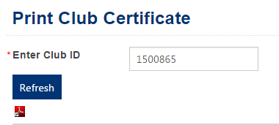
How to download Affiliation Certificate once your application is approved
Go to Club Admin Home (please refer to slide 6)
Scroll to the bottom of the page to the header 'Print Certificate'.
If your club's affiliation form has been approved you will see a link 'Click and enter Club ID to Print Certificate'. There will be no link displayed in this area if your club's application has not been approved.
A new page will appear. Please enter your Club ID into the Club ID field.
Click on the Refresh button
A preview of the Affiliation Certificate will display. Please note that the preview is not what your downloaded Affiliation certificate will look like.
To download your Club Affiliation Certificate click on the red PDF icon
To retain a copy of your certificate, please save the PDF to your local directory. Please note that it can also be accessed via GOL at any stage by following the steps above.

Slide 33
State Association Process

Slide 34
New Online State Association Process
STATE LOGS
ONTO STAFF SITE
CLUB NOTIFIED ACTION REQUIRED
SENT BACK
DASHBOARD DISPLAYS RENEWALS
CLUB NOTIFIED OF OUTCOME
STATE
REVIEWS CLUB RENEWALS
STATE APPROVES / REJECTS RENEWAL

Slide 35
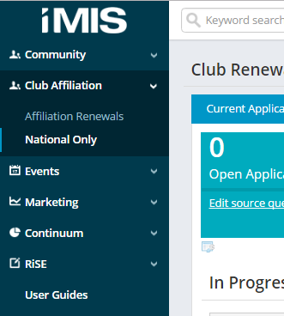
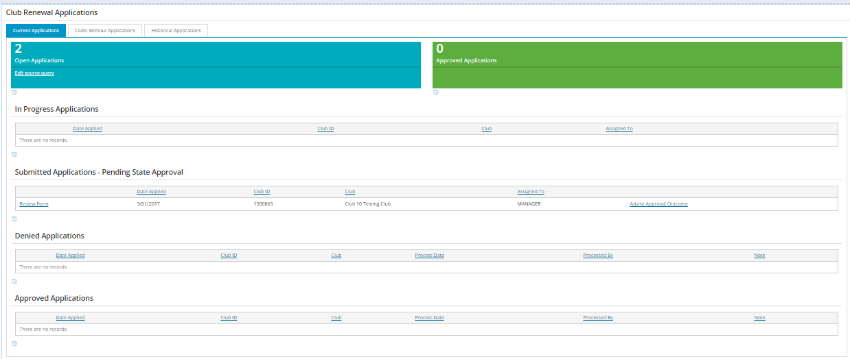
Finding the Affiliation Renewals Dashboard in the Staff Site
Log into http://staff.gymnastics.org.au/
Select Club Affiliation, then Affiliation Renewals in the left hand menu.
The Club Affiliation Renewals Dashboard will display.

Slide 36
Instructions for National staff who look after ACT & TAS
Log into http://staff.gymnastics.org.au/
Select Club Affiliation, then National Only in the left hand menu.
Select either ACT or TAS.
The Club Affiliation Renewals Dashboard will display for the state selected.

Slide 37
Using the Club Affiliation Dashboard
Top Tabs:
Affiliation Dashboard
In Progress Applications (not ready to be reviewed)
Submitted Applications Pending Approval (ready to be reviewed)
Denied Applications (review completed)
Approved Applications (review completed)

Slide 38
How to check if an application is in progress
in Progress Applications can be found here. No action are required for these reports

Slide 39
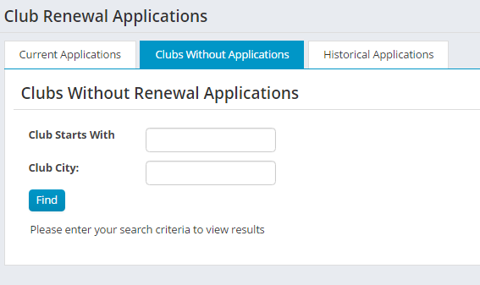
How to check if an application has not been started

Slide 40
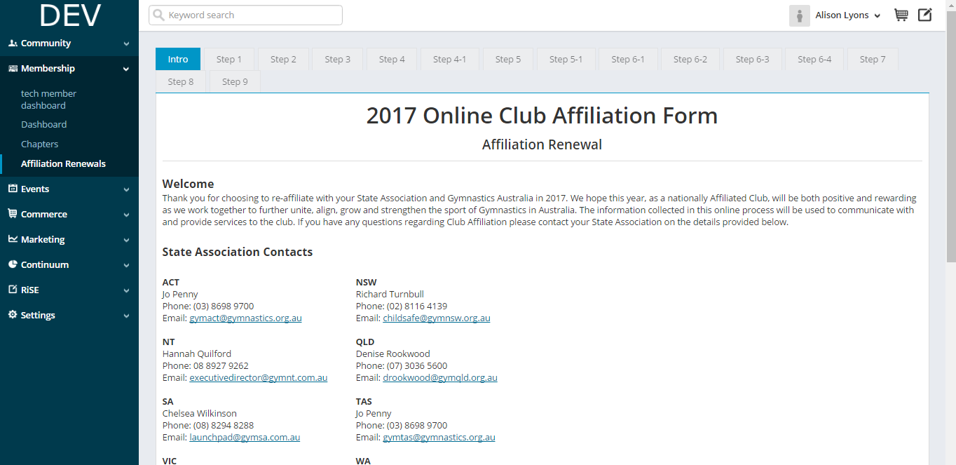
How to review submitted applications

Slide 41
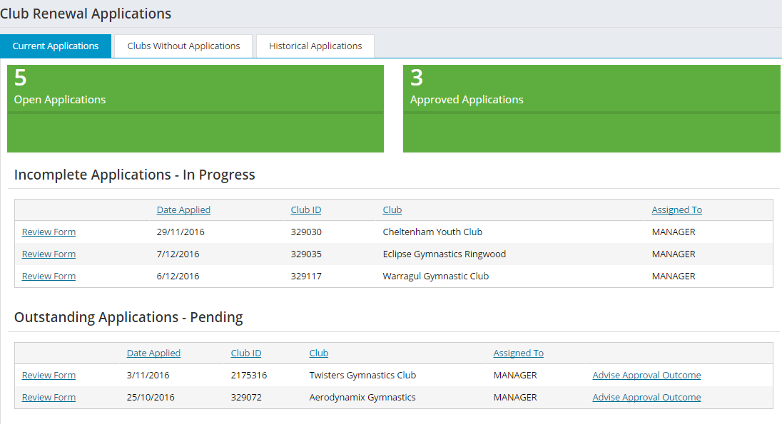
Submitted applications have a Pending Status

Slide 42
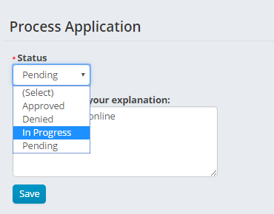
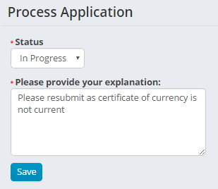
How to have applications resubmitted
This will trigger the Affiliation Button to re-appear on the Club Admin Portal and send an email to the club admin

Slide 43
Resubmit Emails to Clubs

Slide 44
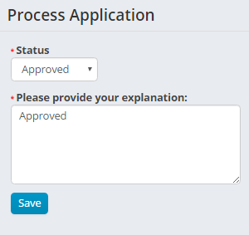
How to approve applications
Trigger approval email to be sent

Slide 45
Approval Emails

Slide 46
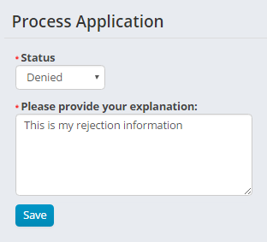
How to deny applications
Triggers denial email to be sent

Slide 47
Denied Application Email

Slide 48
How to check historical applications
This table will be populated in later years.

Slide 49
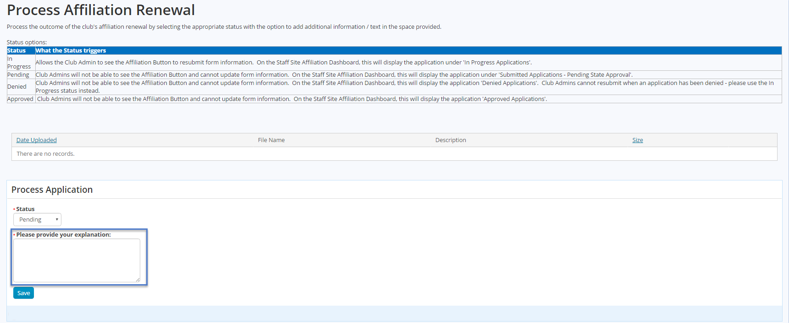
Staff Site> Affiliation Renewals> Advise Approval Outcome
The Please provide your explanation section provides the State Association the opportunity to enter any follow-up details for the club, such as:
the status of adding / removing a club personnel or member based on any notes provided by the club
indicate to the club if any information is outstanding or incomplete in their affiliation renewal application
indicate to the club the status of their affiliation renewal i.e. denied with a reason
These details will appear in the notification email the club receives once the State Association selects Save to continue

Slide 50
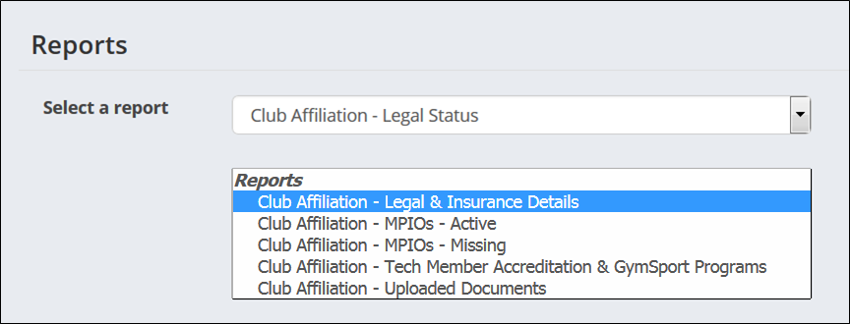
Affiliation Reports
Affiliation Reports can be accessed on the Staff Site via:
Reports > Club Affiliation Reports
Select the drop-down to view available reports
All reports are specific to the State user that is logged in i.e. the user will only see clubs within their State
All reports list currently affiliated clubs
The purpose of the reports is to assist in verifying information captured by the clubs during the affiliation process e.g. confirming gymsports and tech member accreditation
All reports can be exported into the following formats Excel, PDF, Word, CSV & XML. We recommend using Excel to perform further analysis with the data
Note, running or exporting the reports does not affect the data, including any manipulation or analysis done in Excel, once exported, as this is separate from the system

Slide 51
About Affiliation Reports
Report | Can be seen by | Purpose
Club Affiliation – Affiliated Club Details | State Association | Details of clubs in state who have affiliated for current year.
Club Affiliation – Legal & Insurance Details | State Association | To assist State Associations in determining incomplete information (as not all fields are mandatory in the Club Affiliation process)
Club Affiliation – MPIOs - Active | State Association | To assist State Associations during the Club Affiliation process and meeting Club Affiliation Standards
Club Affiliation – MPIOs - Missing | State Association | To assist State Associations and clubs as it's a legal requirement as part of the Club Affiliation process
Club Affiliation – Notes for Address | State Association | To assist State Associations during the Club Affiliation Renewal process as clubs are not able to delete old address details / locations
Club Affiliation – Notes for Members | State Association | To assist State Associations during the Club Affiliation Renewal process if clubs are not able to find club personnel or technical members
Club Affiliation – Personnel List | State Association | To assist State Associations and/or clubs in determining their personnel list and identifying personnel that are no longer with the club
Club Affiliation – Tech Member Accreditation & GymSport Programs | State Association | To assist State Associations in determining correct Technical Member accreditation and Gymsport programs offered Ensures clubs have accredited coaches/judges based on the Gymsport Programs offered Provides data for further statistical analysis by State Associations
National: Club Affiliation – MPIOs – Active | National Association | To assist Gymnastics Australia during the Club Affiliation process and meeting Club Affiliation Standards

Slide 52
About Affiliation Reports
Report | Can be seen by | Purpose
Club Affiliation – Uploaded Documents | State Association | To assist State Associations in determining what supporting documents were uploaded during the Club Affiliation Renewal process Provides a link to download and verify uploaded documents
Club Data – Club Admin Email Review | State Association | To ensure data quality when sending out email notifications during the Club Affiliation Renewal process and other club related communication To receive a copy of the Club Affiliation Renewal form on submission or the online form
Club Data – Club Email Address Review | State Association | To ensure all clubs have provided a club email address which is displayed in the Club finder.
Club Data – Paid Thru Missing | State Association | To check all Clubs have a paid thru date.
National: Club Affiliation – Discount Token List | National Association | To help to determine if Clubs are eligible for discount tokens in their affiliation packs.
National: Club Affiliation – Legal Status | National Association | To assist Gymnastics Australia in determining incomplete information (as not all fields are mandatory in the Club Affiliation process)
National: Club Affiliation – MPIOs – Active | National Association | To assist Gymnastics Australia during the Club Affiliation process and meeting Club Affiliation Standards

Slide 53
About Affiliation Reports
Report | Can be seen by | Notes
National: Club Affiliation – MPIOs - Missing | National Association | To assist Gymnastics Australia and clubs as it's a legal requirement as part of the Club Affiliation process
National: Club Affiliation – Notes for Address | National Association | To assist Gymnastics Australia during the Club Affiliation Renewal process as clubs are not able to delete old address details / locations
National: Club Affiliation – Notes for Members | National Association | To assist Gymnastics Australia during the Club Affiliation Renewal process if clubs are not able to find club personnel or technical members
National: Club Affiliation – Personnel List | National Association | To assist Gymnastics Australia and clubs in determining their personnel list and identifying personnel that are no longer with the club
National: Club Affiliation – Tech Member Accreditation & GymSport Programs | National Association | To assist Gymnastics Australia in determining correct Technical Member accreditation and Gymsport programs offered Ensures clubs have accredited coaches/judges based on the Gymsport Programs offered Provides data for further statistical analysis by State Associations
National: Club Affiliation Status | National Association | To assist Gymnastics Australia in determining what supporting documents were uploaded during the Club Affiliation Renewal process Provides a link to download and verify uploaded documents

Slide 54
About Affiliation Reports
Report | Can be seen by | Notes
National: Club Affiliation – Desktop to Date | National Association | To check which Clubs have affiliated via a manual desktop process for the current year to today.
National: Club Affiliation – Weekly | National Association | To check which Clubs have affiliated via online renewals form process for the current year during the current week
National: Club Affiliation – Weekly Desktop | National Association | To check which Clubs have affiliated via a manual desktop process for the current year during the current week.
National: Club Affiliation – Club Admin Email Review | National Association | To ensure data quality when sending out email notifications during the Club Affiliation Renewal process and other club related communication To receive a copy of the Club Affiliation Renewal form on submission or the online form
National: Club Affiliation – Club Email Address Review | National Association | To ensure all clubs have provided a club email address which is displayed in the Club finder.
National: Club Affiliation – Paid Thru Missing | National Association | To check all Clubs have a paid thru date.

Slide 55
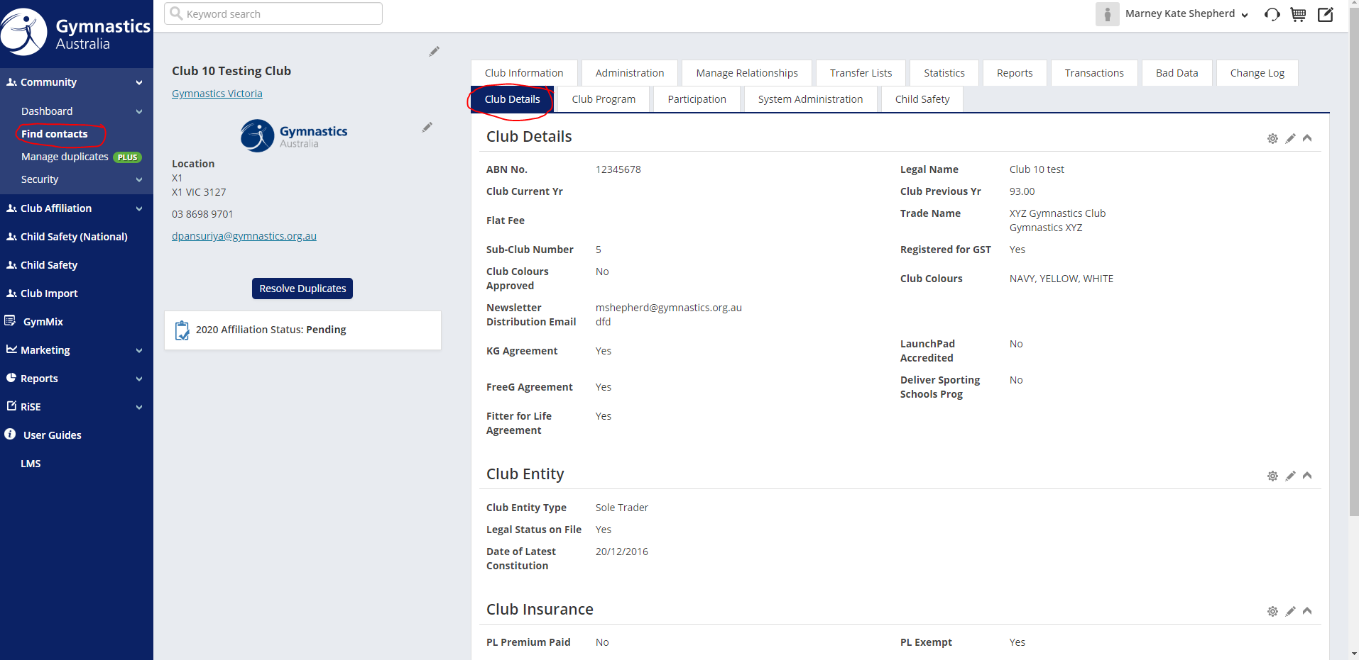
How to make changes in the Club Record on the Staff Site
Go to Staff Site> Find Contacts> Find Club
Once in the club record, go to the Club Details tab and use the pencil icon to edit

Slide 56
Help and Feedback Resources

Slide 57
Online Club Affiliation Renewals Help & Feedback Resources
User help documentation on the Online Club Affiliation Renewals Process can be found via:
Staff User Guides & Support Page (Information for Staff)
Gymnastics Support Page (Information for Clubs)
Clicking on the Information Icons while completing the Online Club Affiliation form.
The 2022 Club Affiliation manual available on the Affiliation Resources Page.
Please contact your State Association or Log a Support Request if you require any further assistance.

